Slide 1

Imaging and Analysis of Post-processing for Discrete Element Method and its Application
Algorithm Description & Calculation Example
Numerical Simulation Experiment
Nanjing University
WEI Huajing
22/06/2020

Slide 2
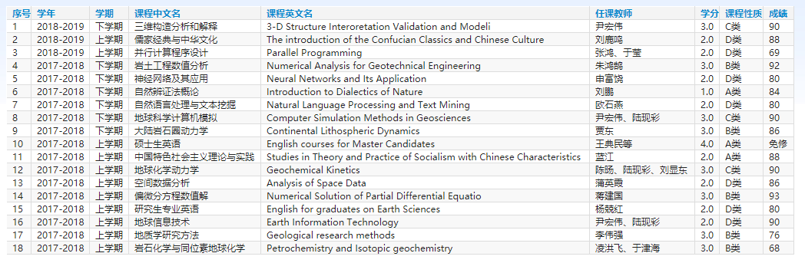
Curriculum
18 courses for 45 credits

Slide 3
Workload
Python Code for Post-processing Algorithm: 56172 lines
2D Compression Structural Experiment: 53 sets
Structural Deformation and Feature Map Figure: 5724 pieces

Slide 4
Outline
Introduction
Algorithm
Example
Experiment
Conclusion

Slide 5
Outline
Introduction
Algorithm
Example
Experiment
Conclusion

Slide 6
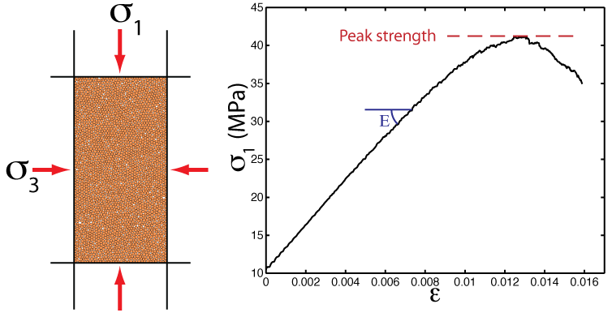
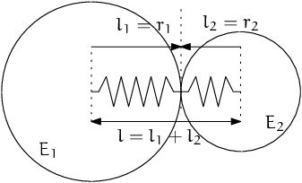
Background
DEM: Discrete Element Model
Micro-granular system for macroscopic object
Based on Newtonian mechanics
Masses of computation

Slide 7
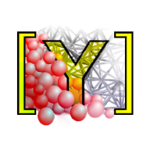
Software
YADE: Yet Another Dynamic Engine
Performed on Linux
Open Source
Python Command Line

Slide 8
Outline
Introduction
Algorithm
Example
Experiment
Conclusion

Slide 9

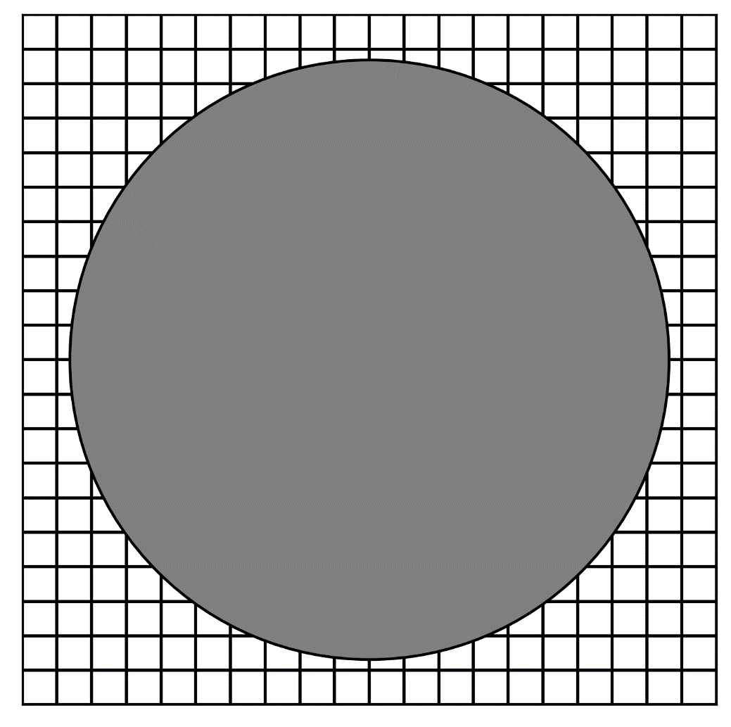
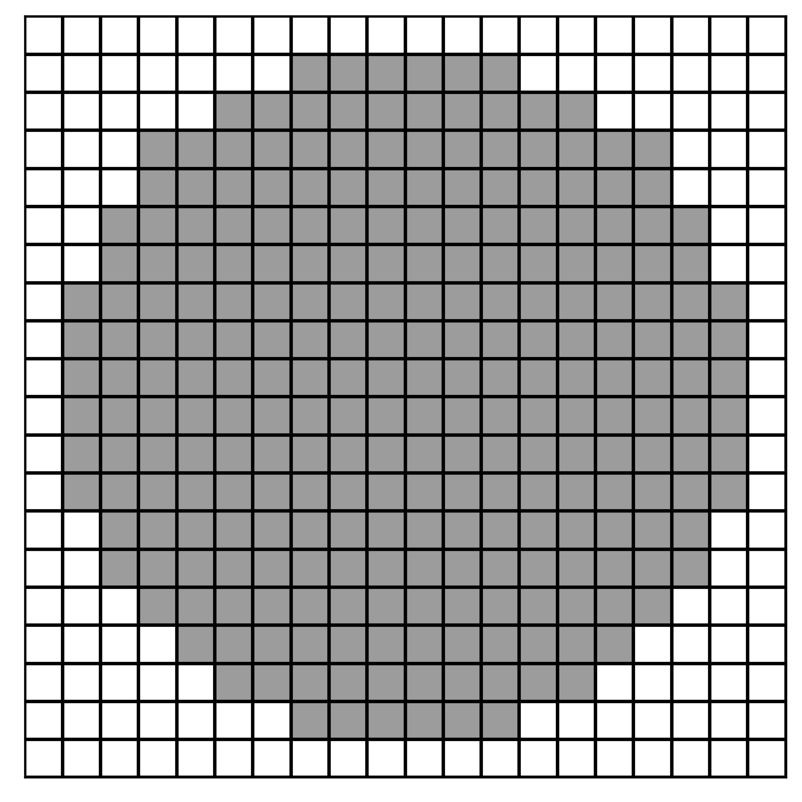


Rasterization
GitHub: https://github.com/jerryweihuajing/Post-Processing

Slide 10
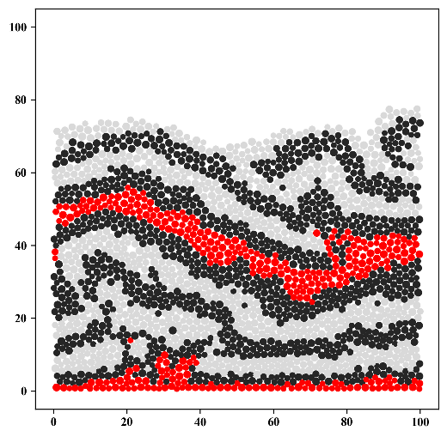
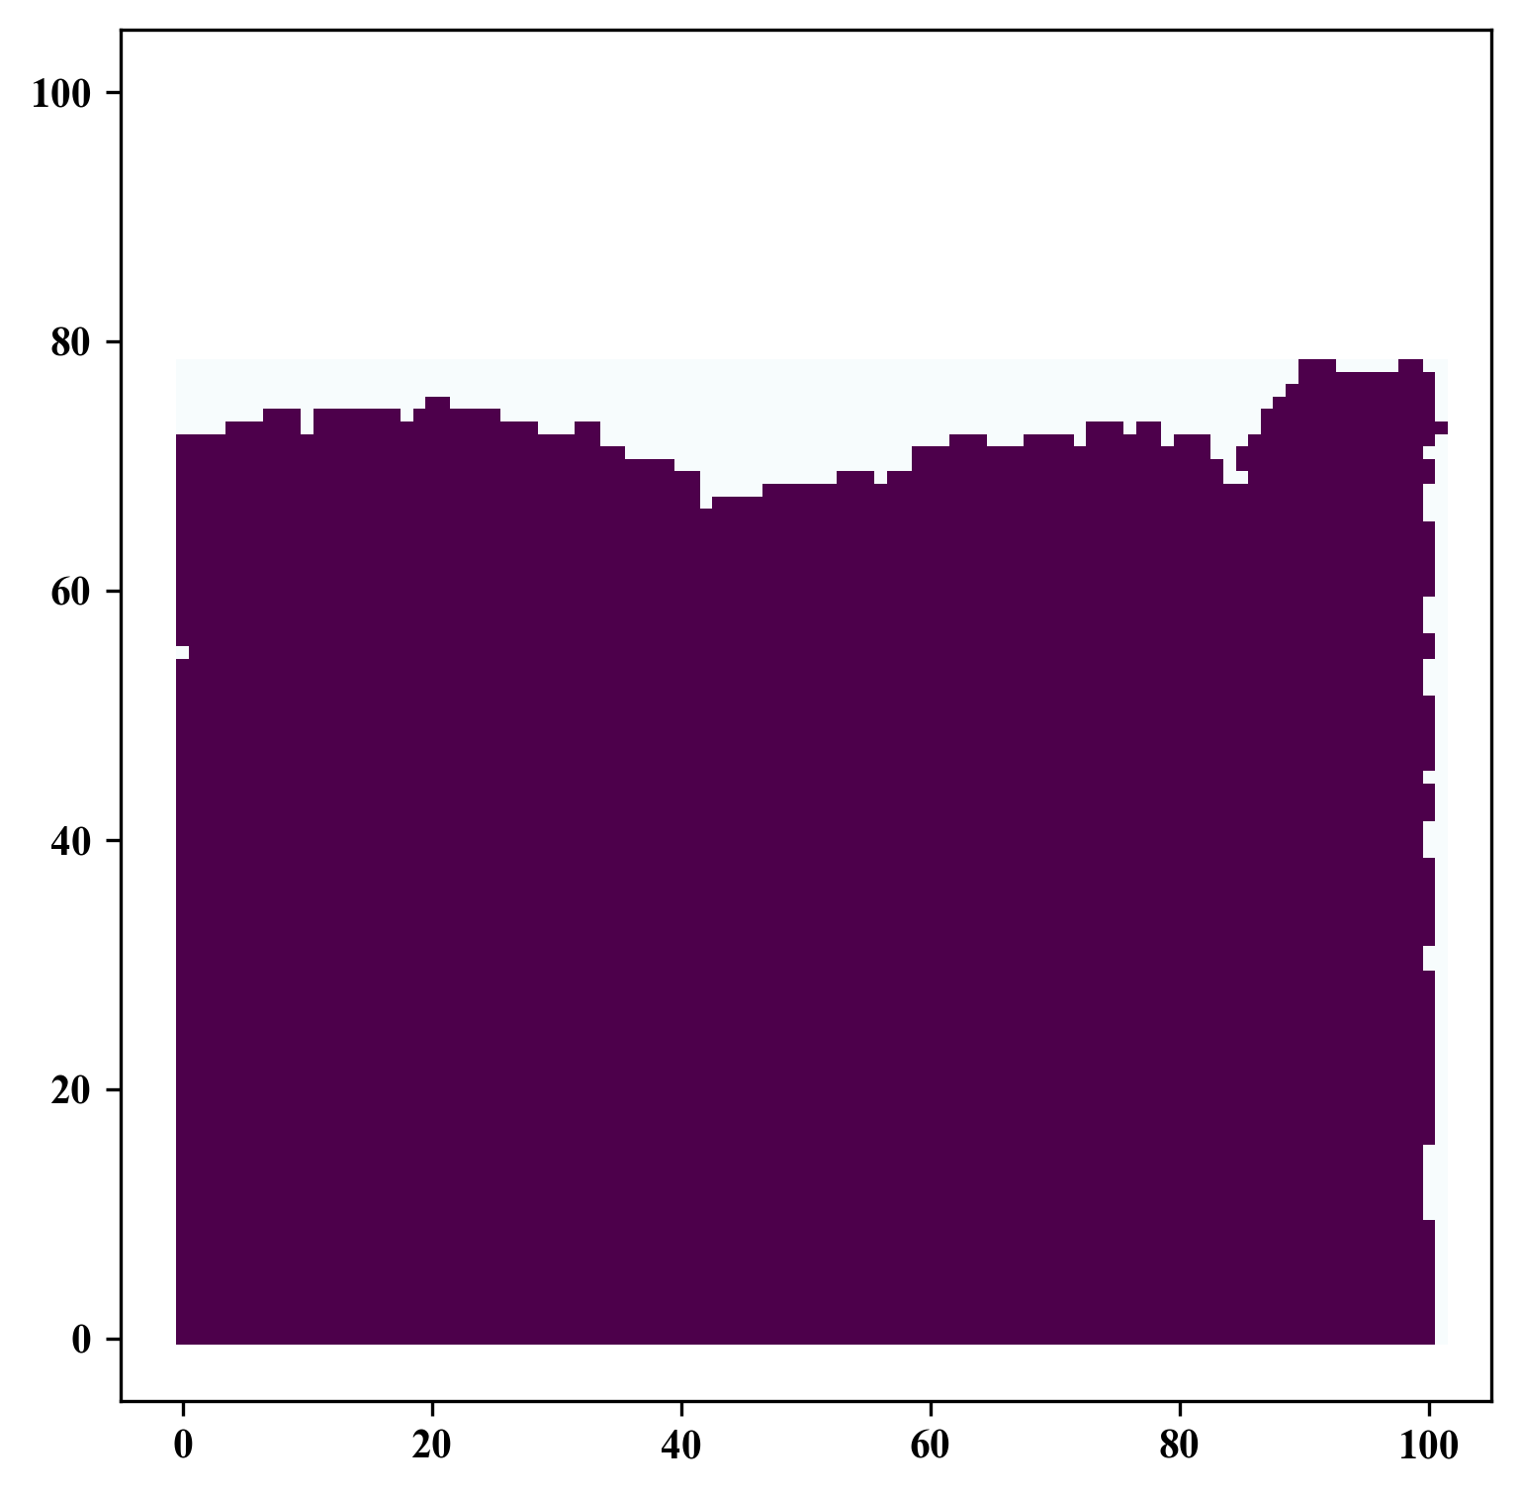
Rasterization
GitHub: https://github.com/jerryweihuajing/Post-Processing

Slide 11
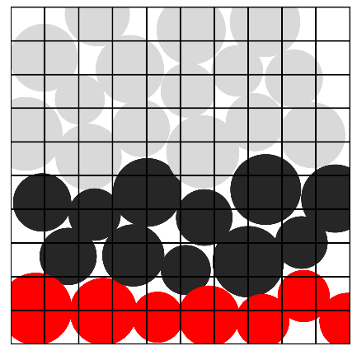
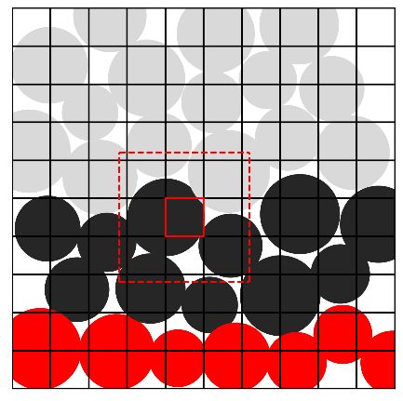
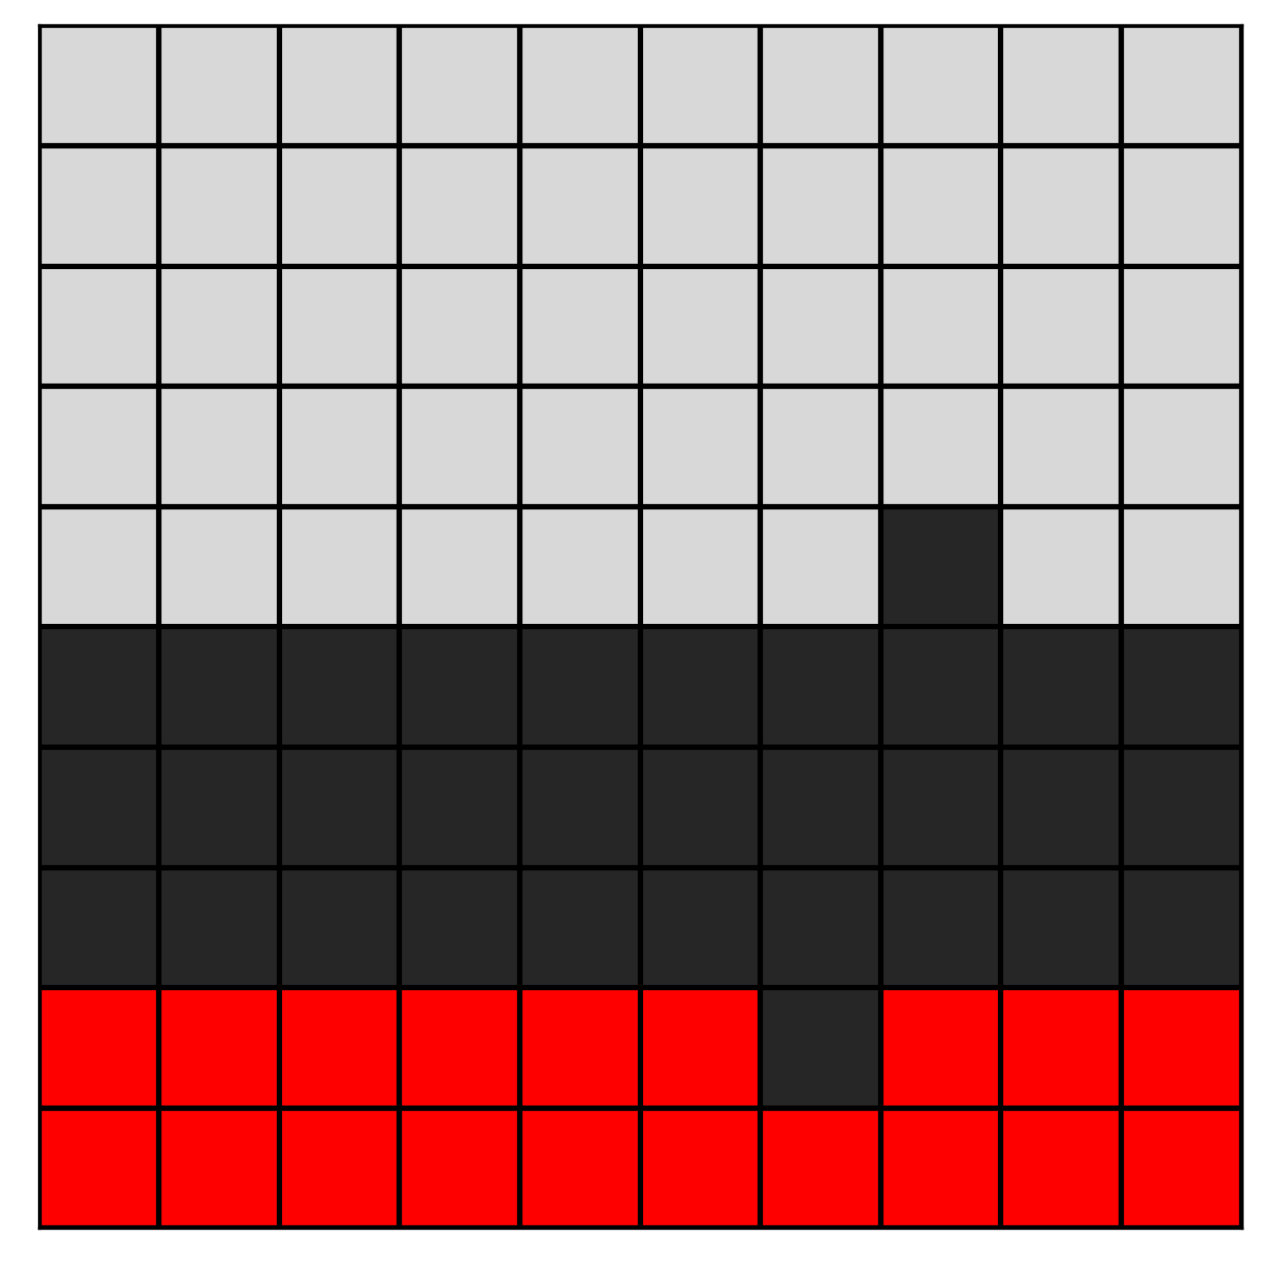
Rasterization
GitHub: https://github.com/jerryweihuajing/Post-Processing

Slide 12

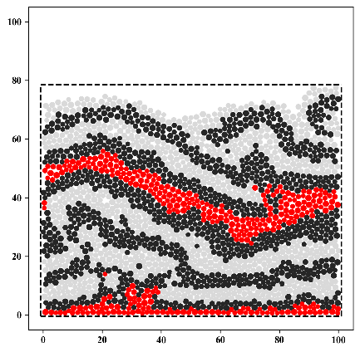
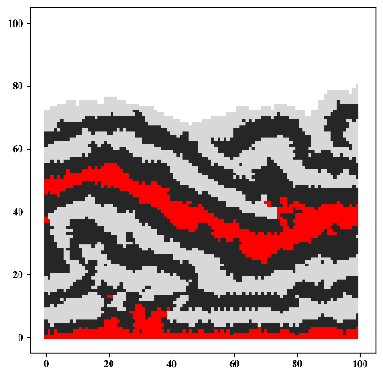
Rasterization
GitHub: https://github.com/jerryweihuajing/Post-Processing

Slide 13
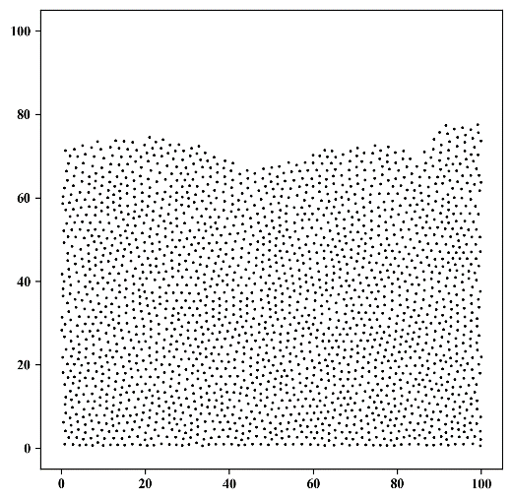
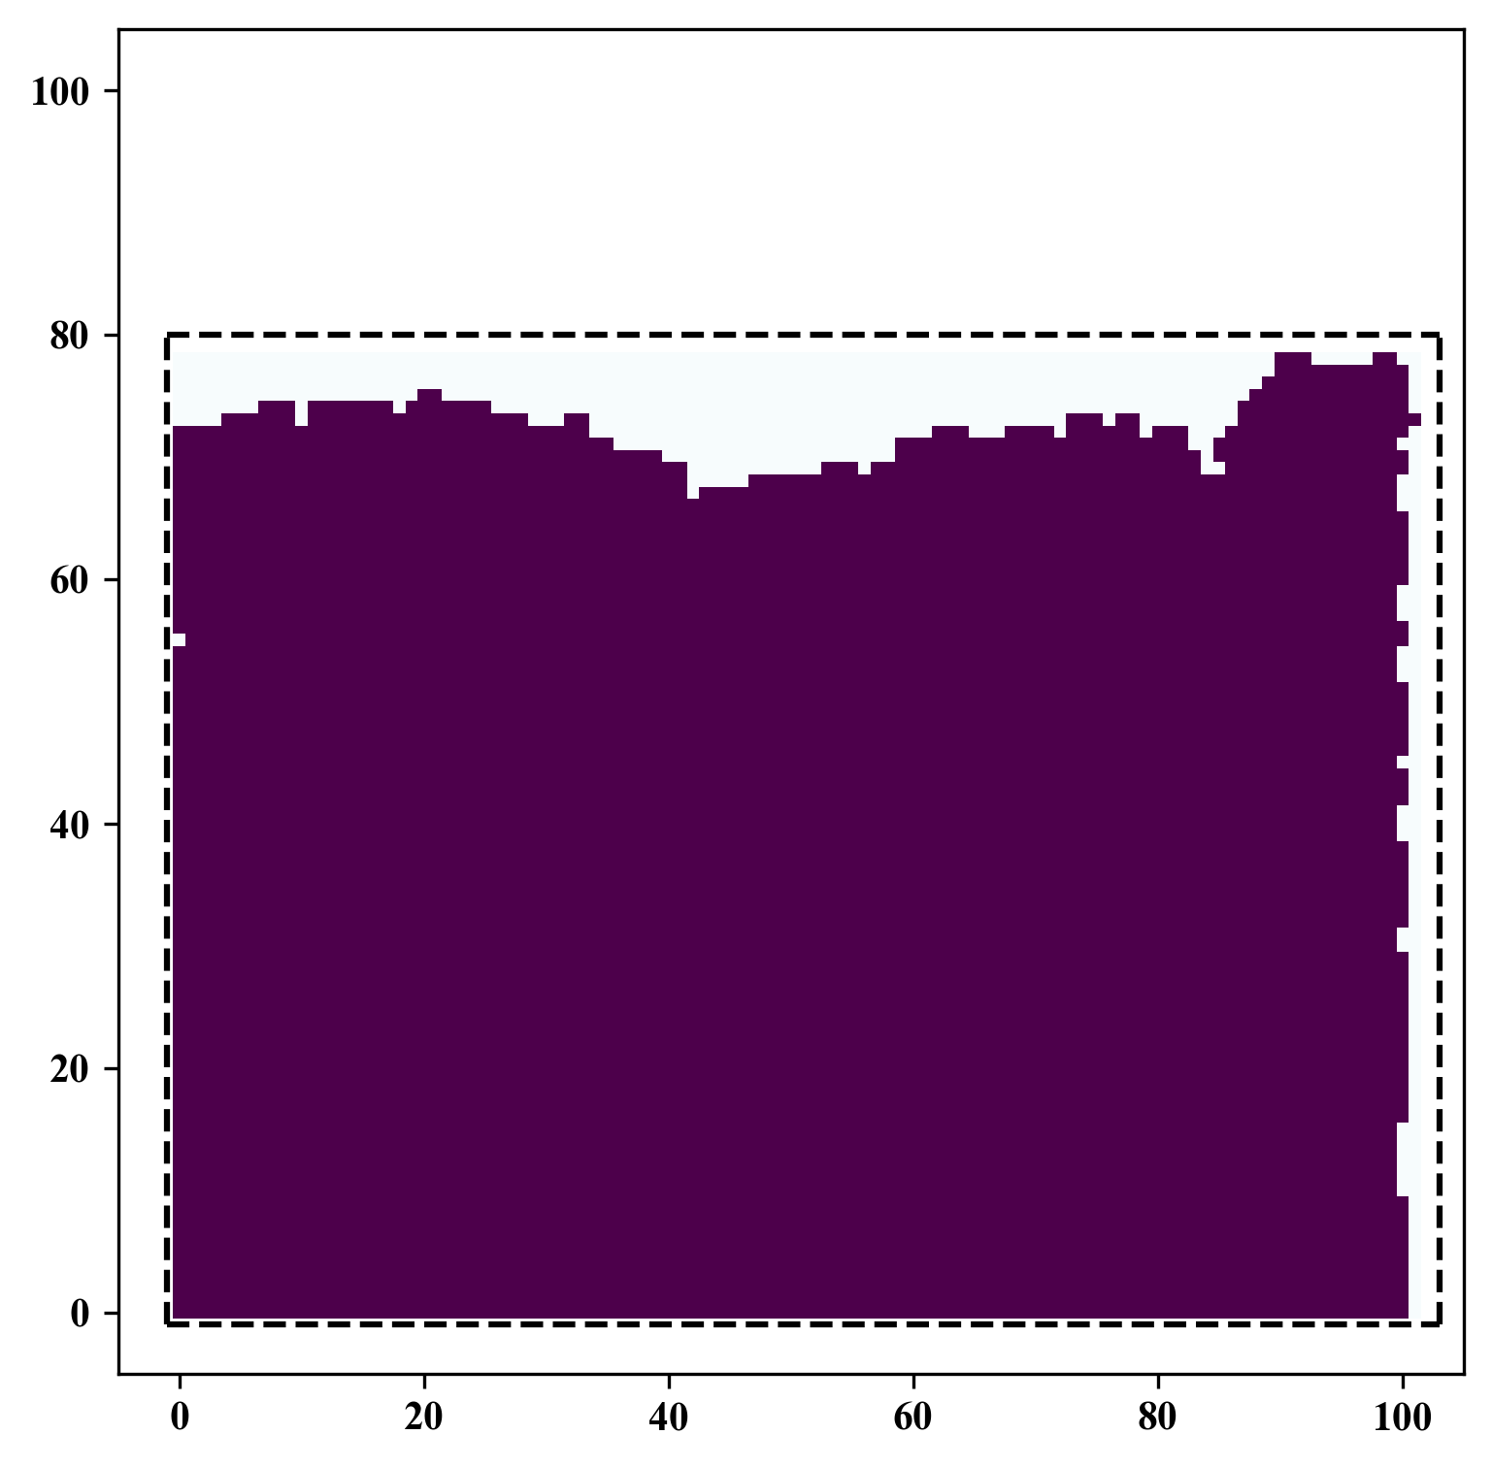
Spatial Interpolation
GitHub: https://github.com/jerryweihuajing/Post-Processing

Slide 14
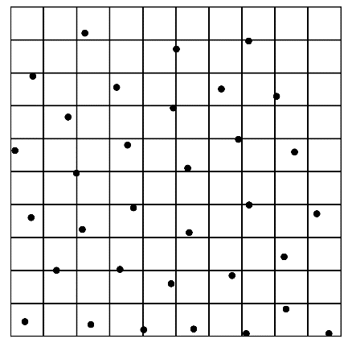
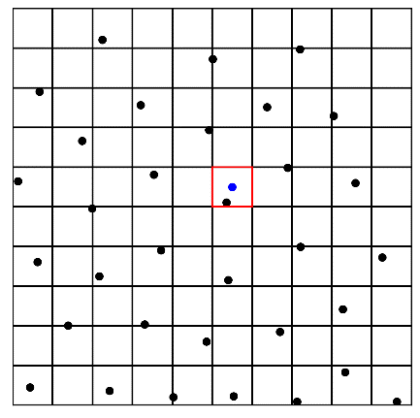
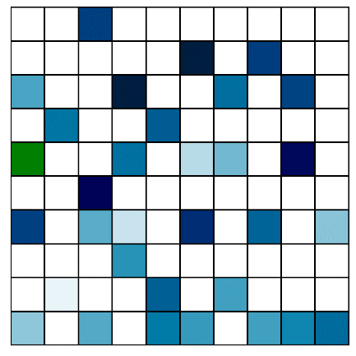
Spatial Interpolation
GitHub: https://github.com/jerryweihuajing/Post-Processing

Slide 15
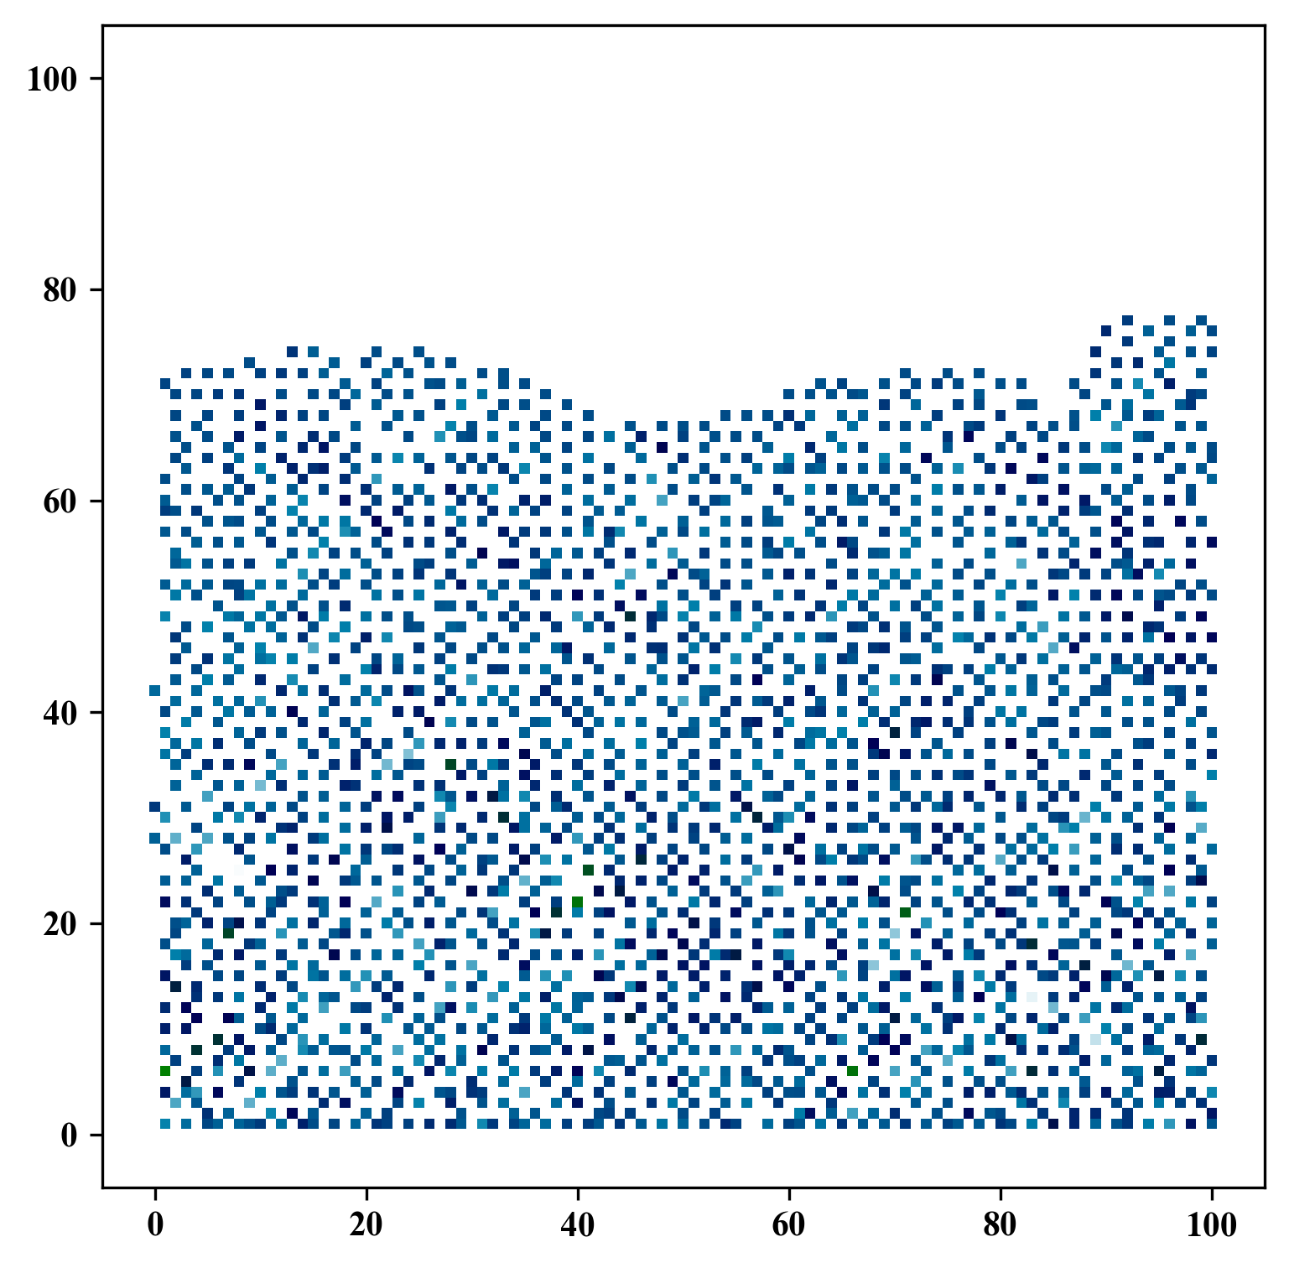
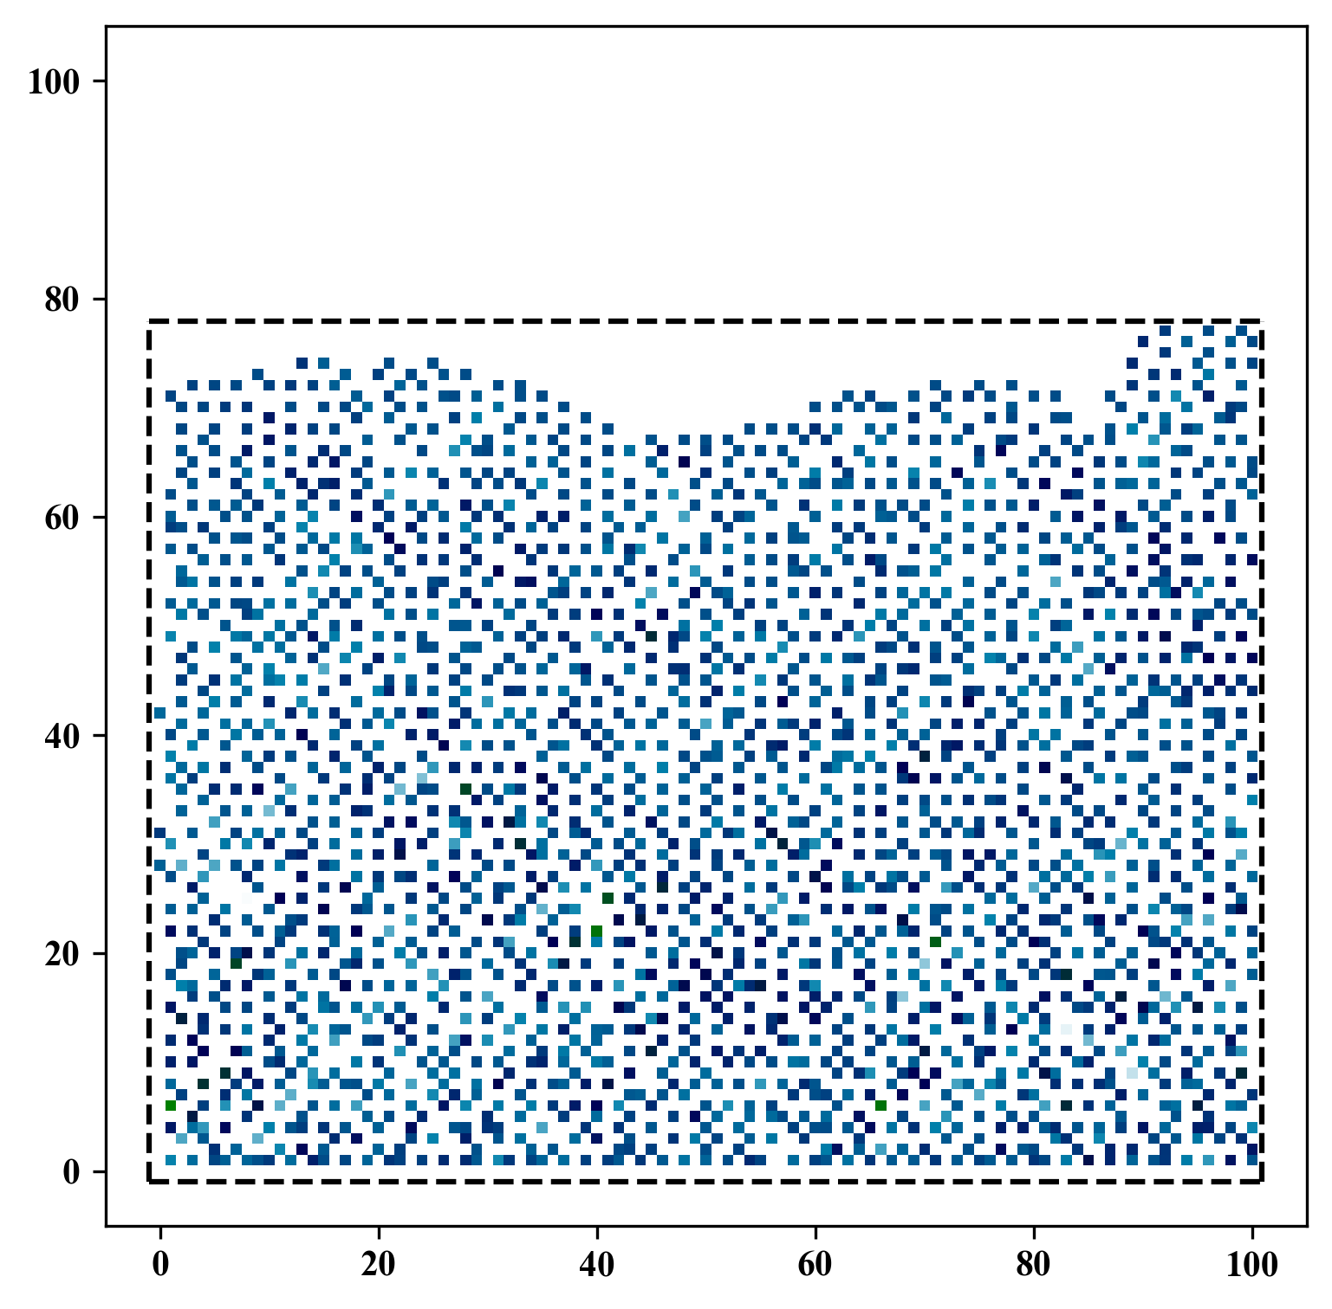
Spatial Interpolation
GitHub: https://github.com/jerryweihuajing/Post-Processing

Slide 16
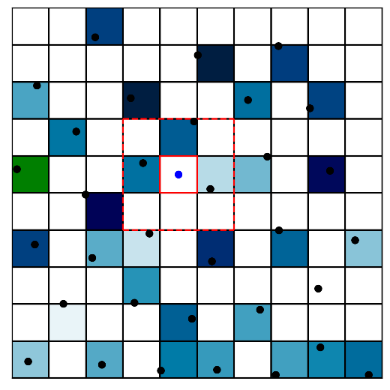
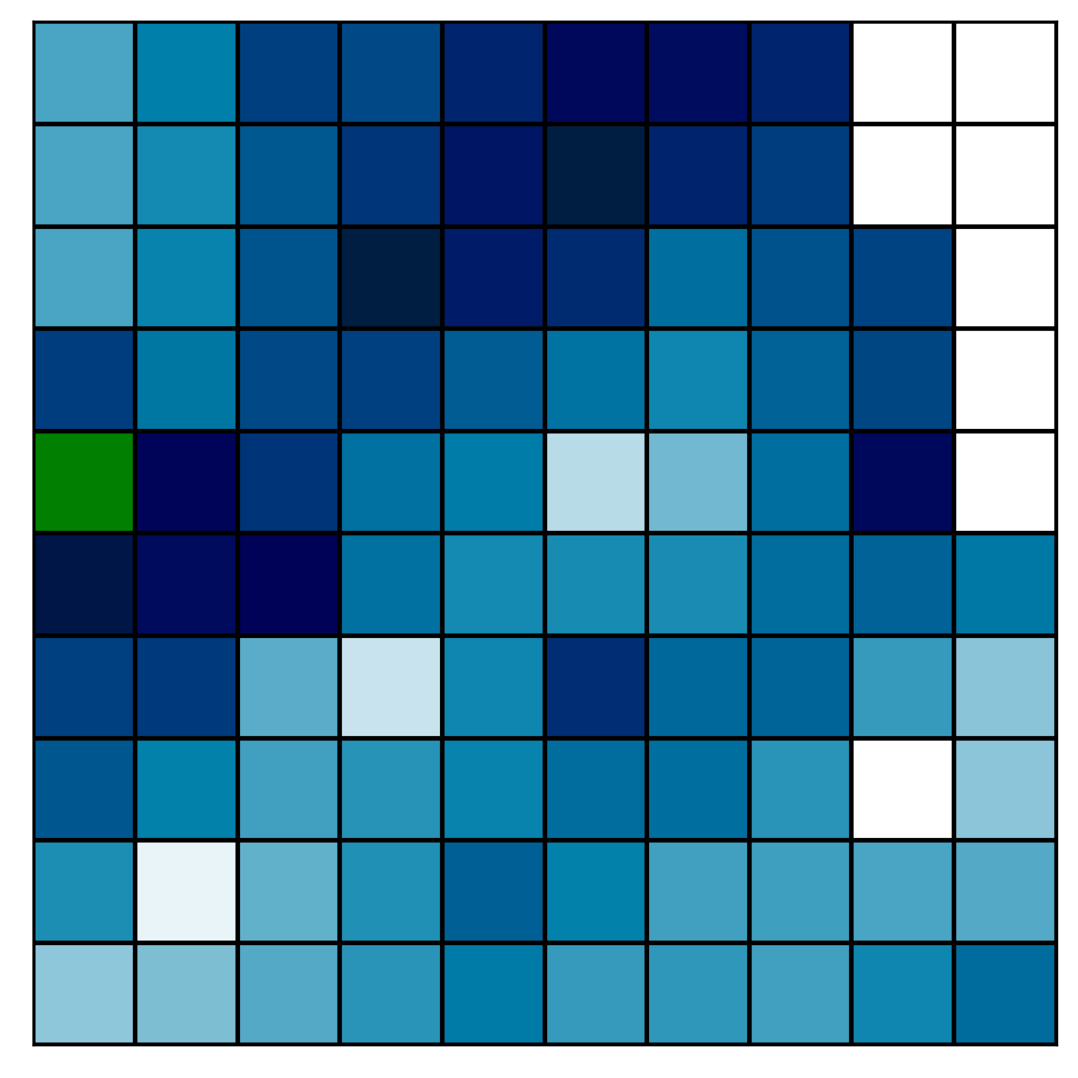
Spatial Interpolation
GitHub: https://github.com/jerryweihuajing/Post-Processing

Slide 17
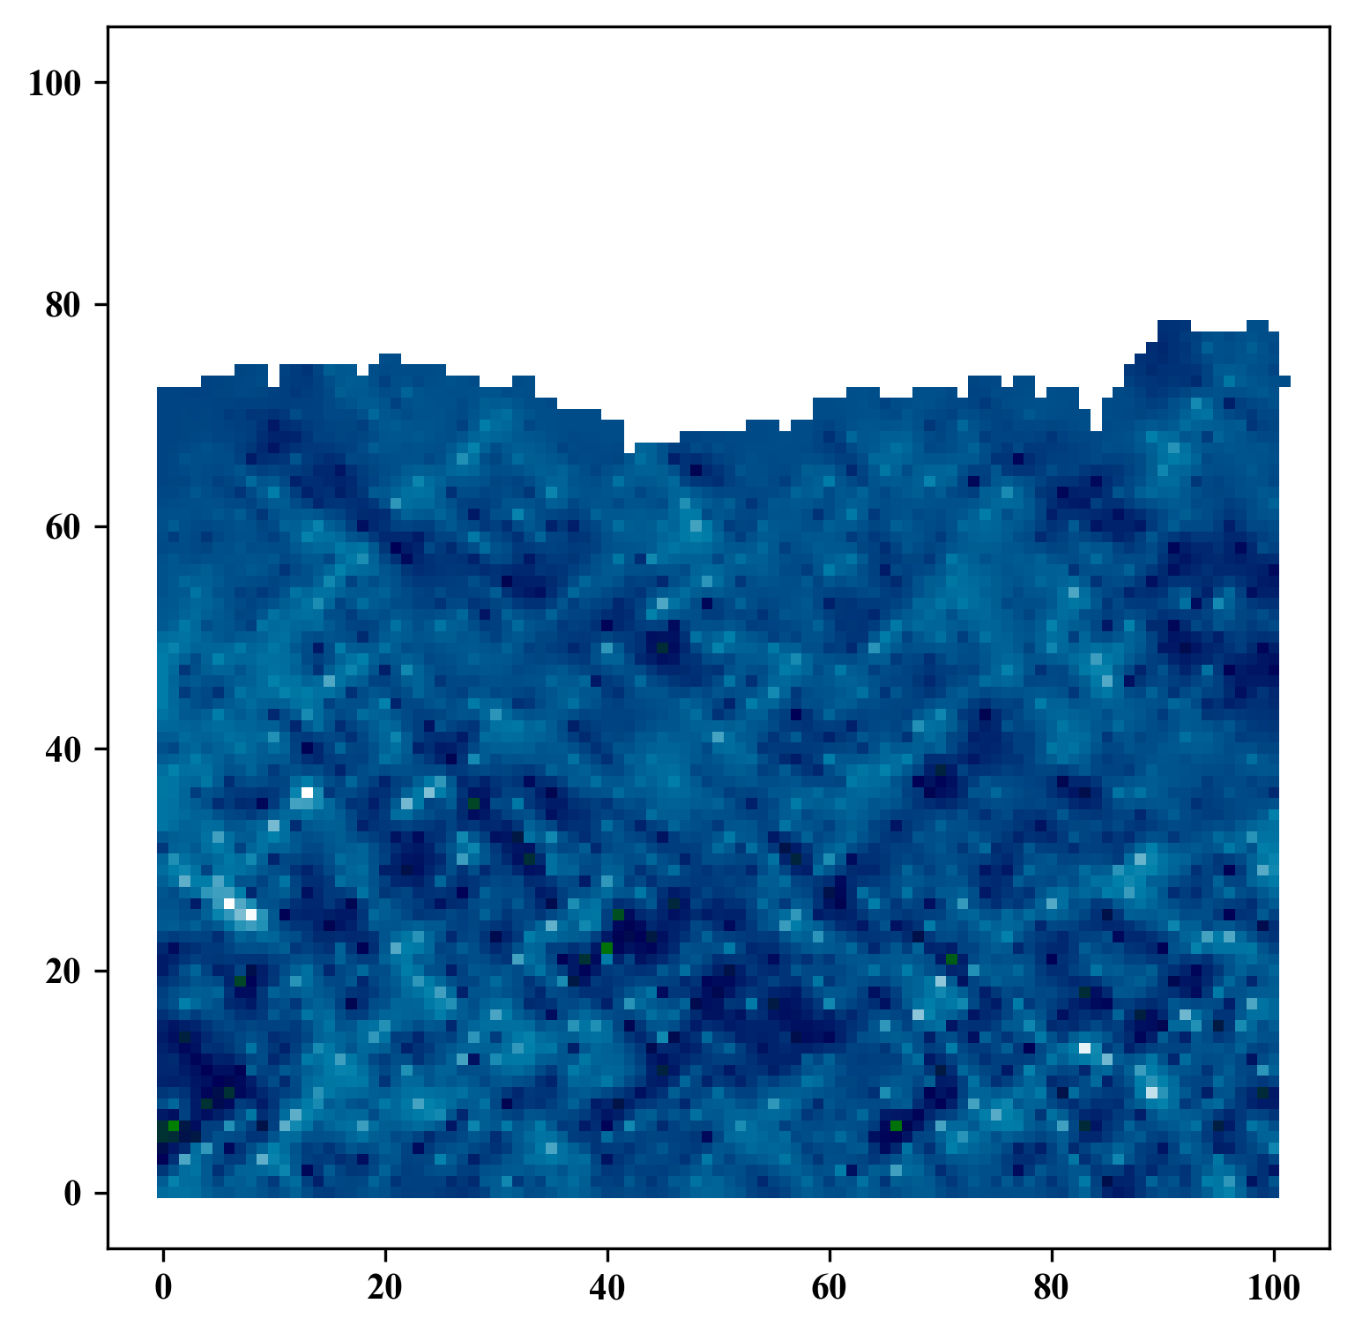
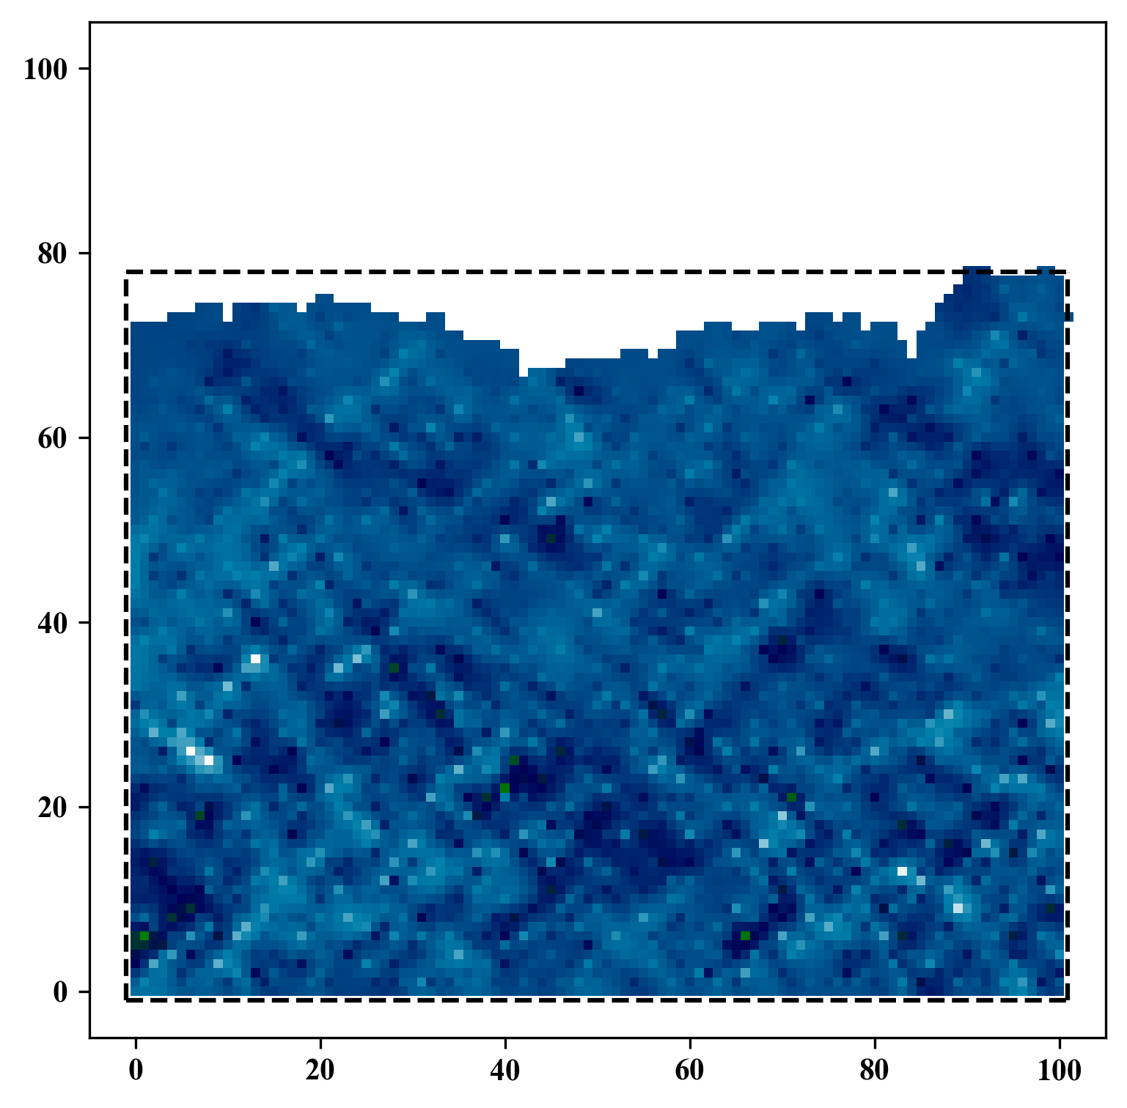
Spatial Interpolation
GitHub: https://github.com/jerryweihuajing/Post-Processing

Slide 18
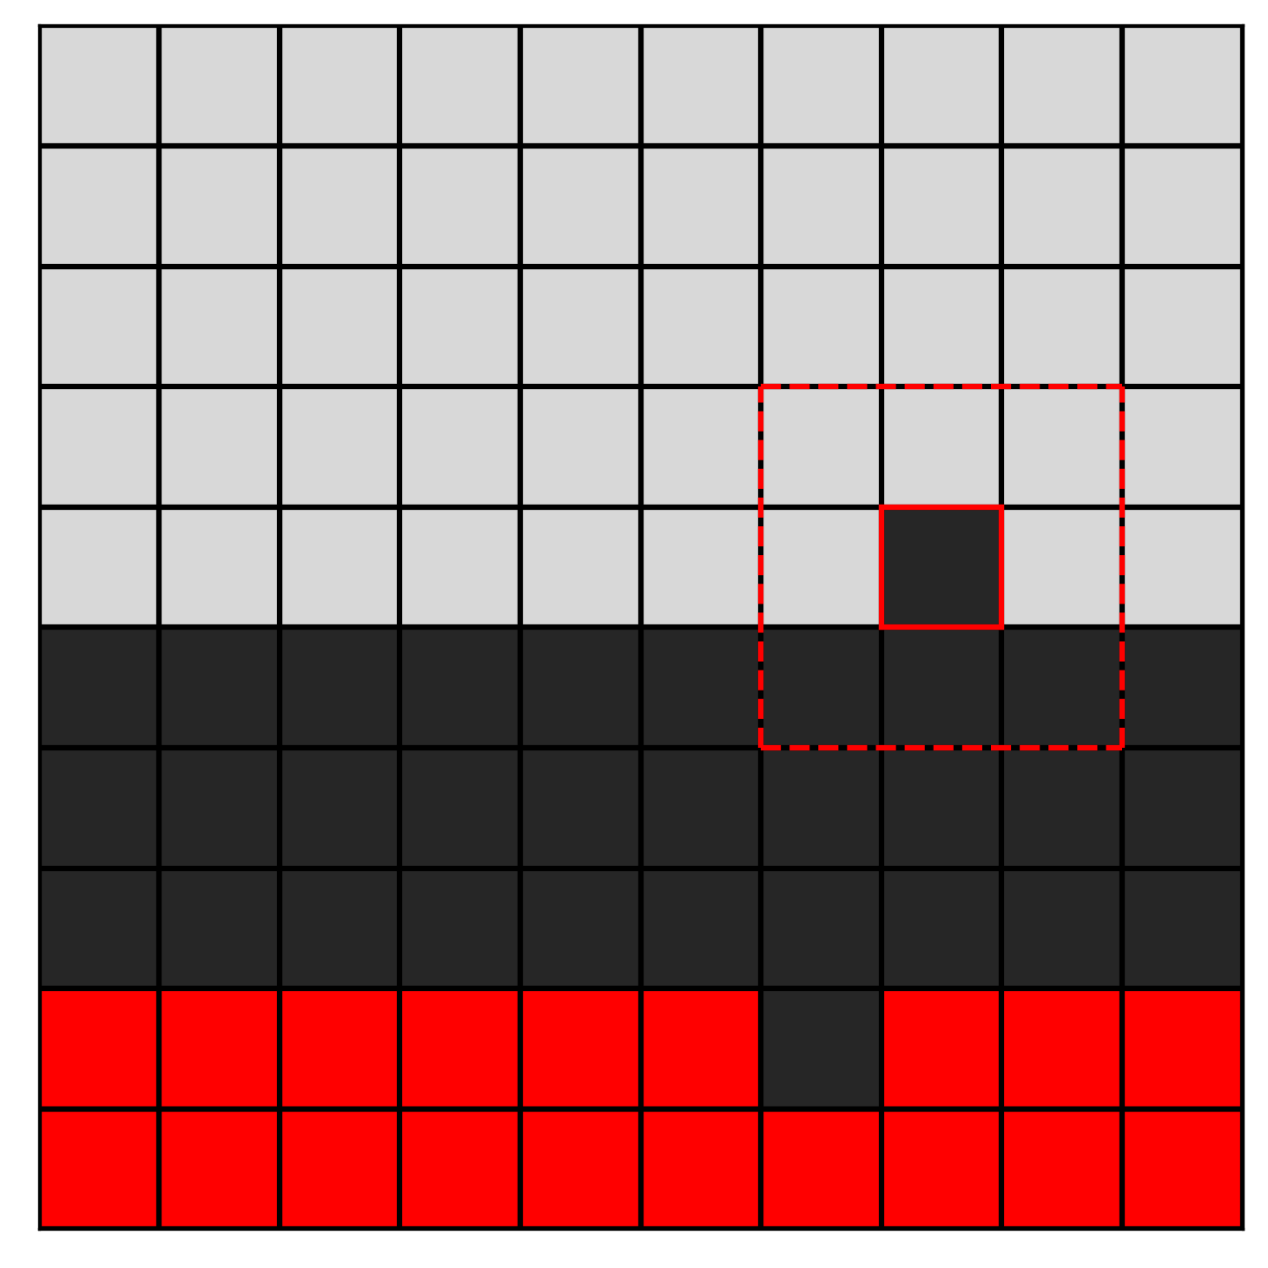
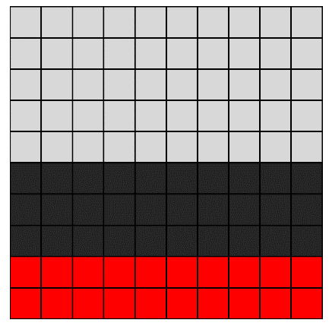
Gaussian Filtering
GitHub: https://github.com/jerryweihuajing/Post-Processing

Slide 19

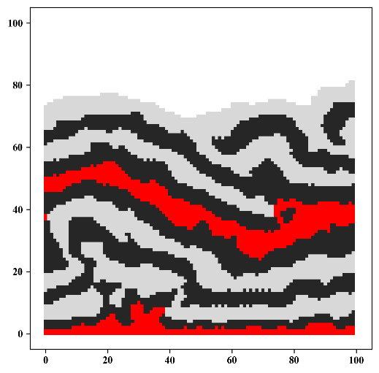
Gaussian Filtering
GitHub: https://github.com/jerryweihuajing/Post-Processing

Slide 20
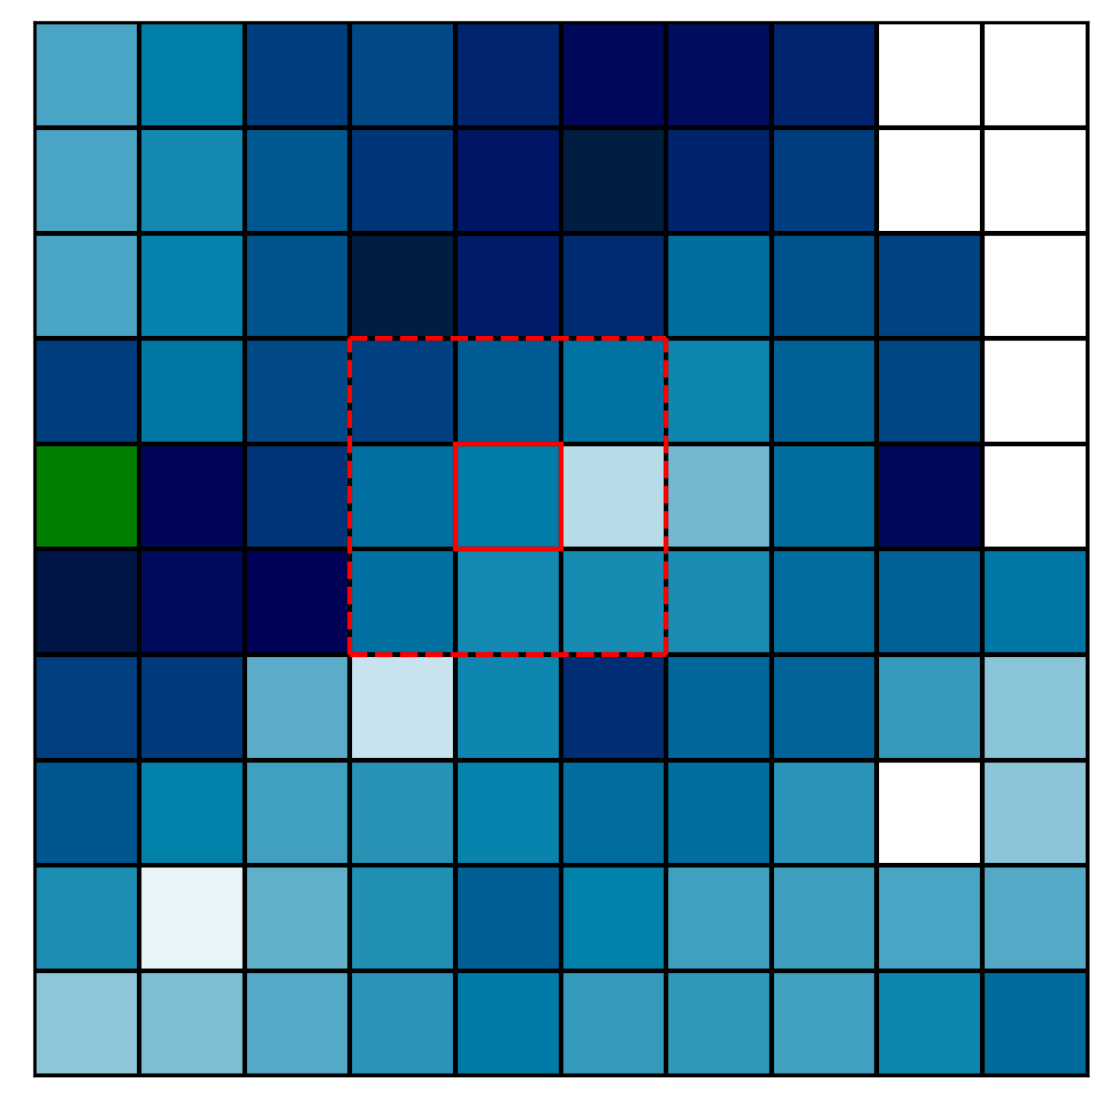
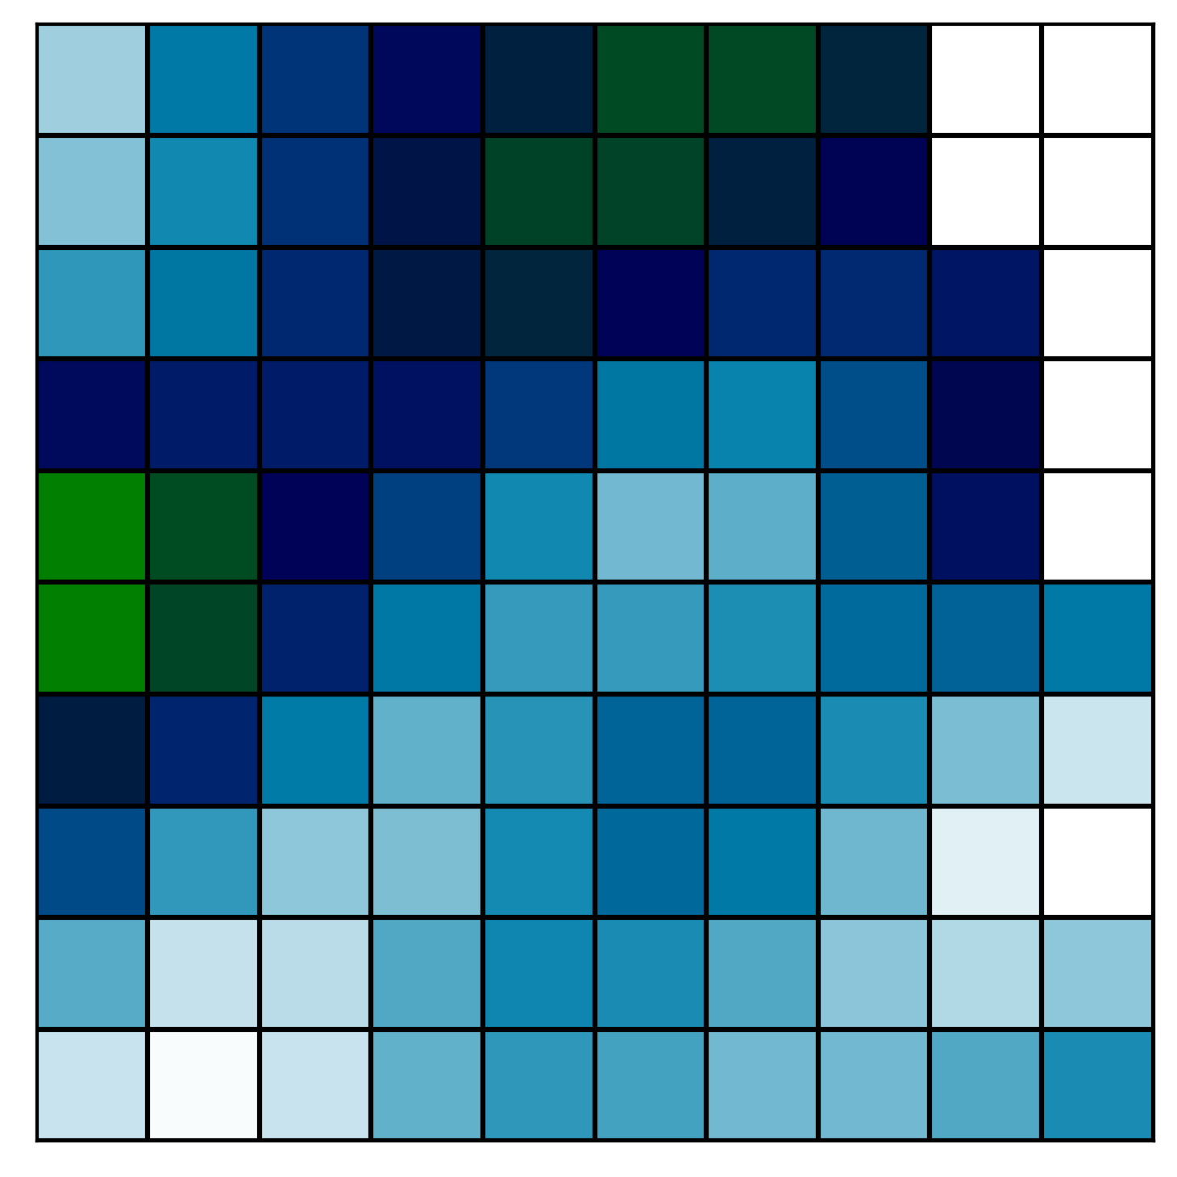
Gaussian Filtering
GitHub: https://github.com/jerryweihuajing/Post-Processing

Slide 21
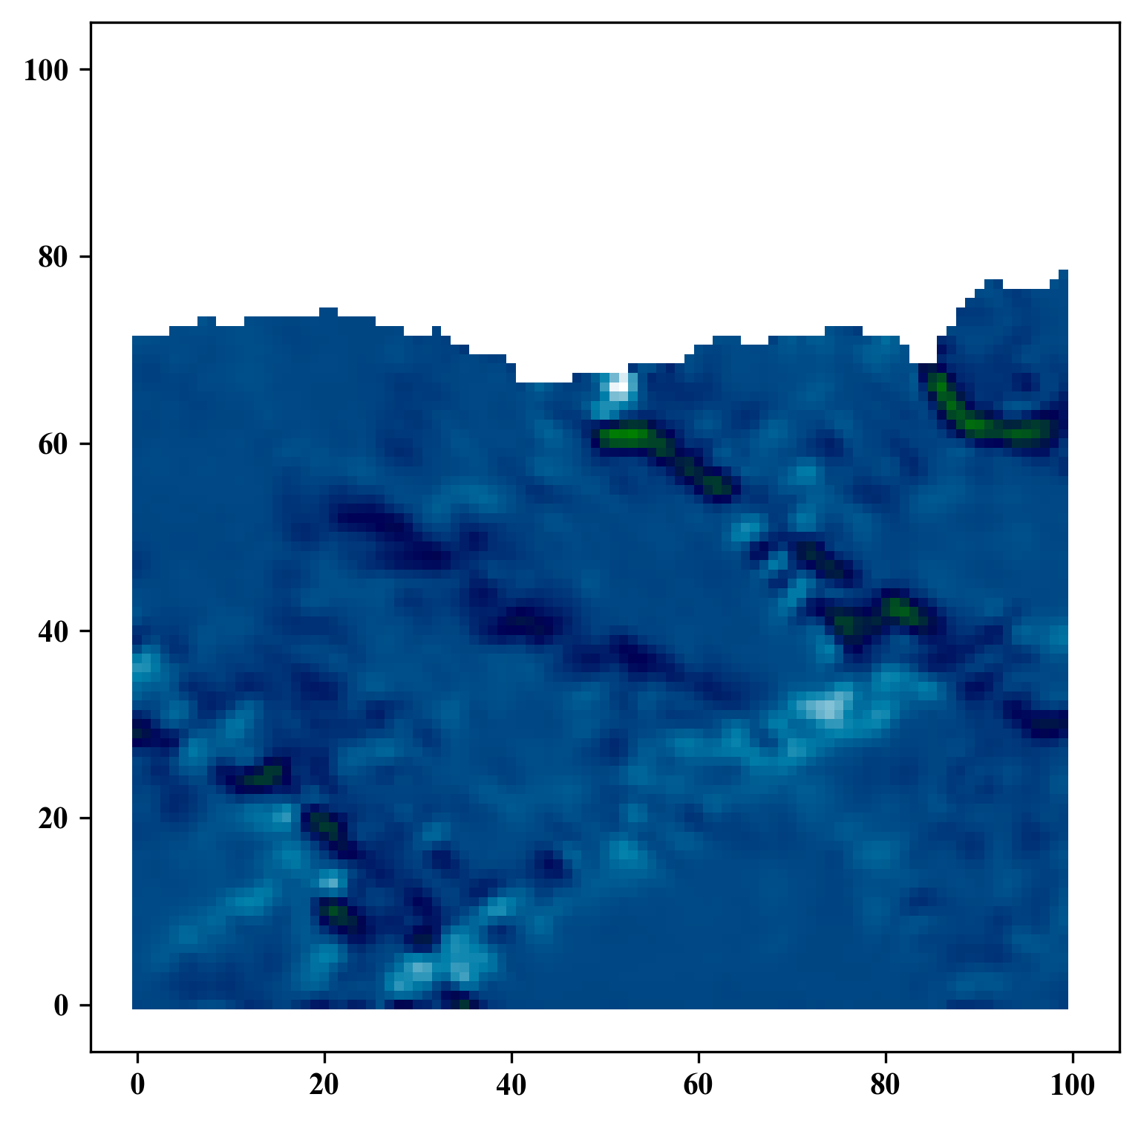
Gaussian Filtering
GitHub: https://github.com/jerryweihuajing/Post-Processing

Slide 22
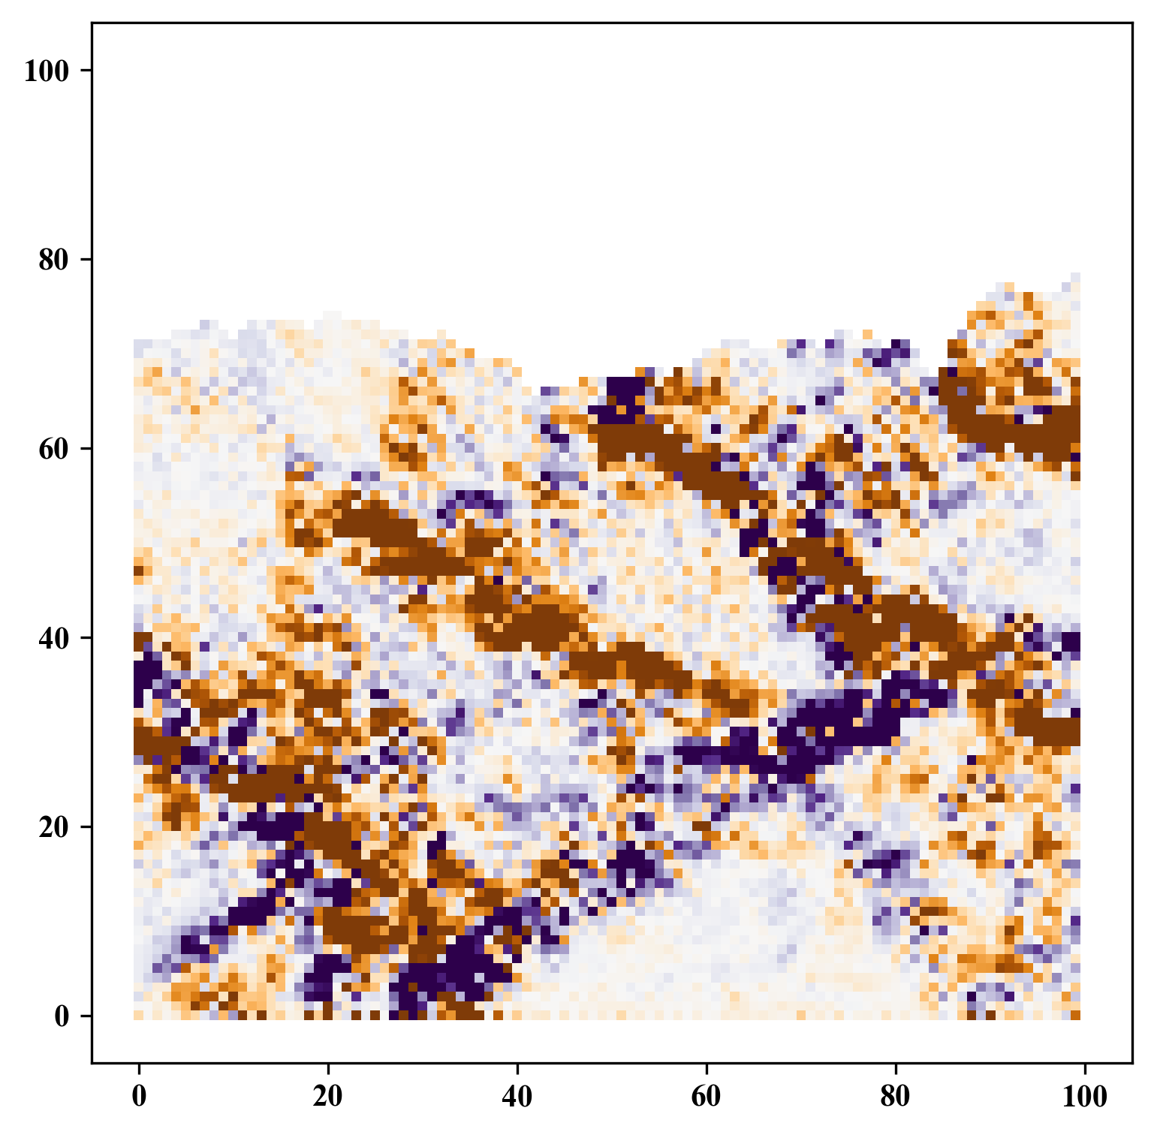
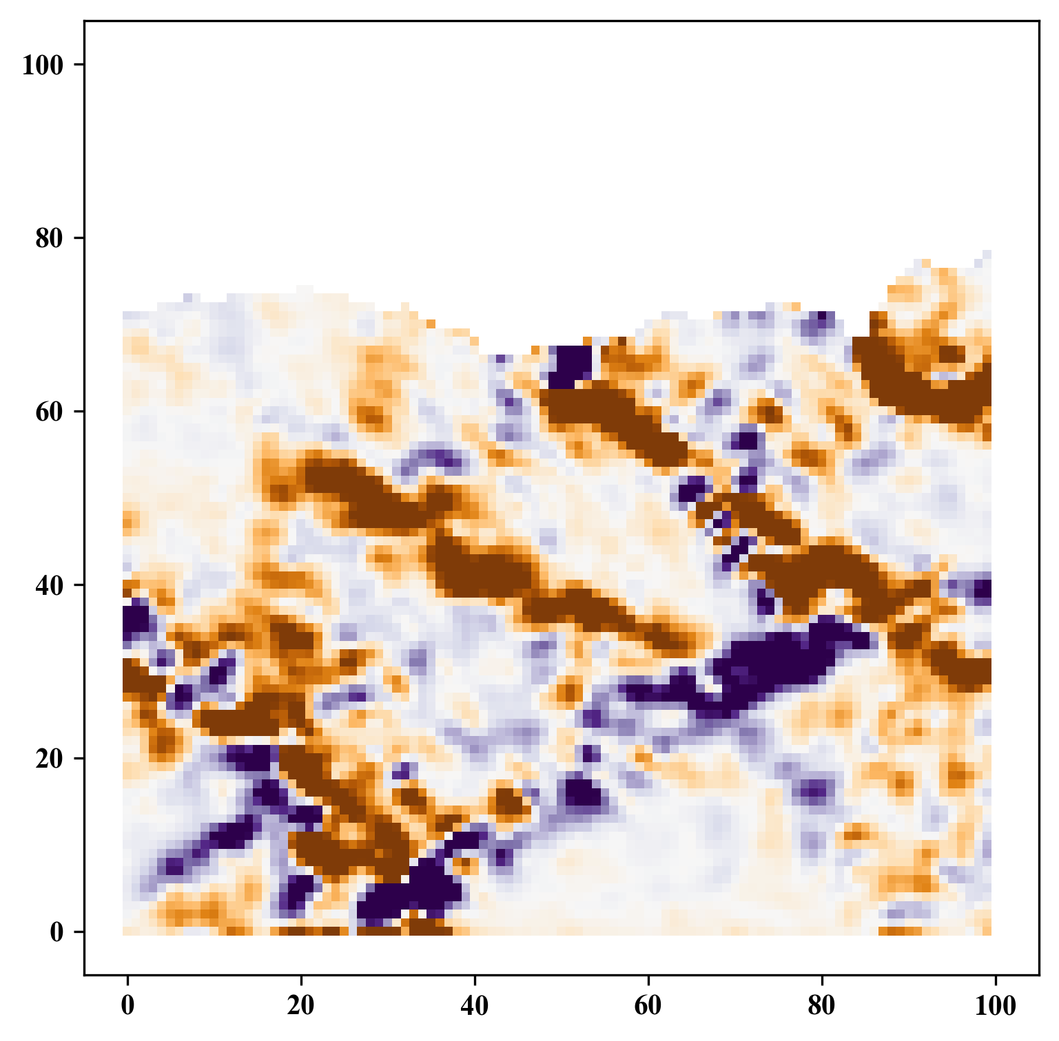
Gaussian Filtering
GitHub: https://github.com/jerryweihuajing/Post-Processing

Slide 23
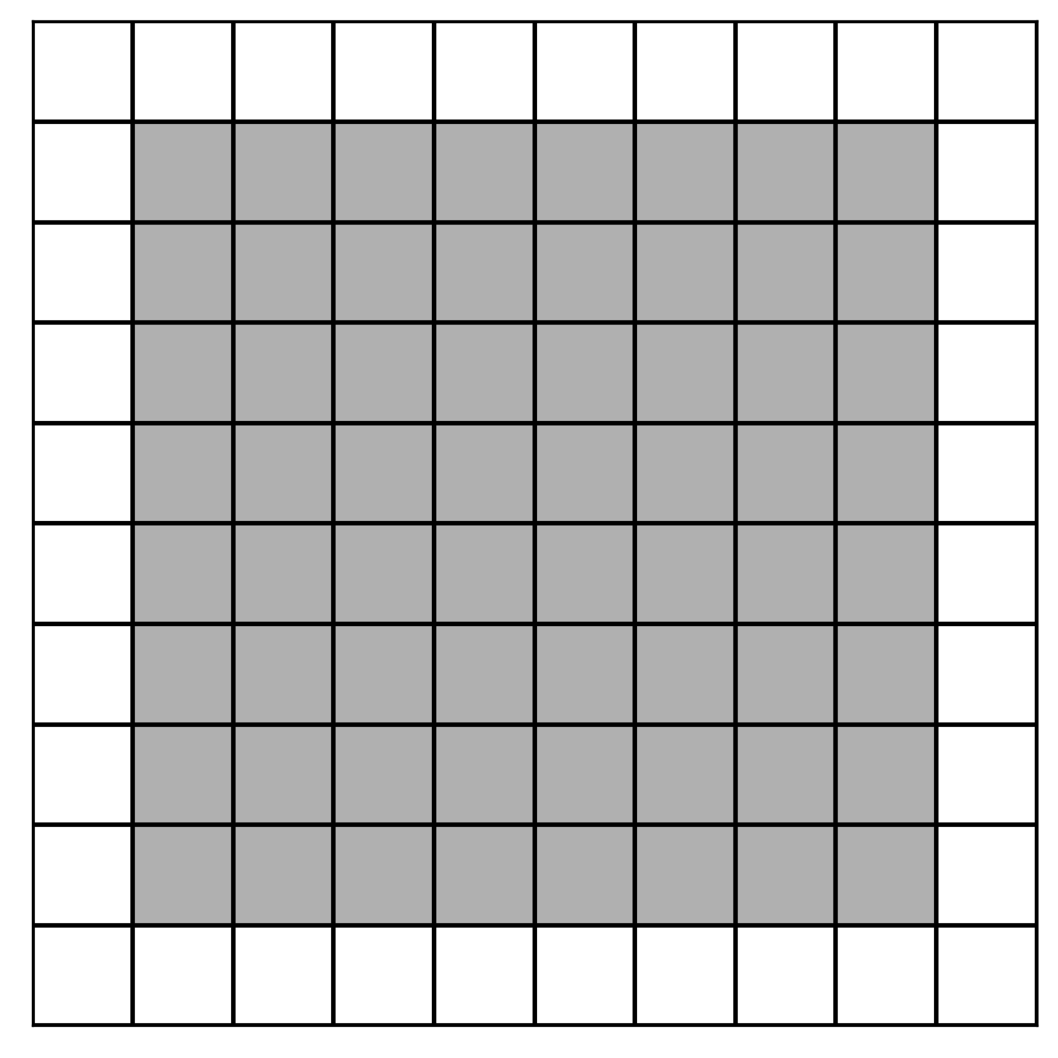
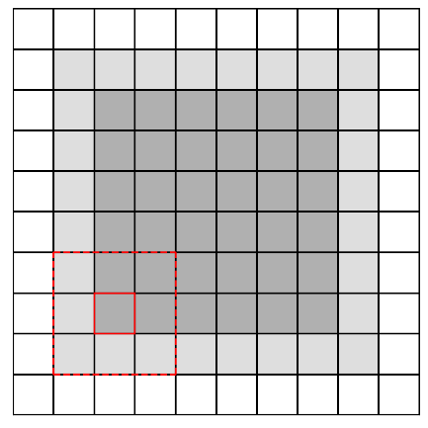
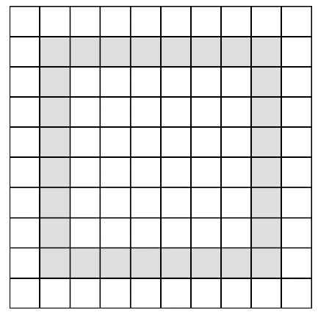
Boundary Extraction
GitHub: https://github.com/jerryweihuajing/Post-Processing

Slide 24
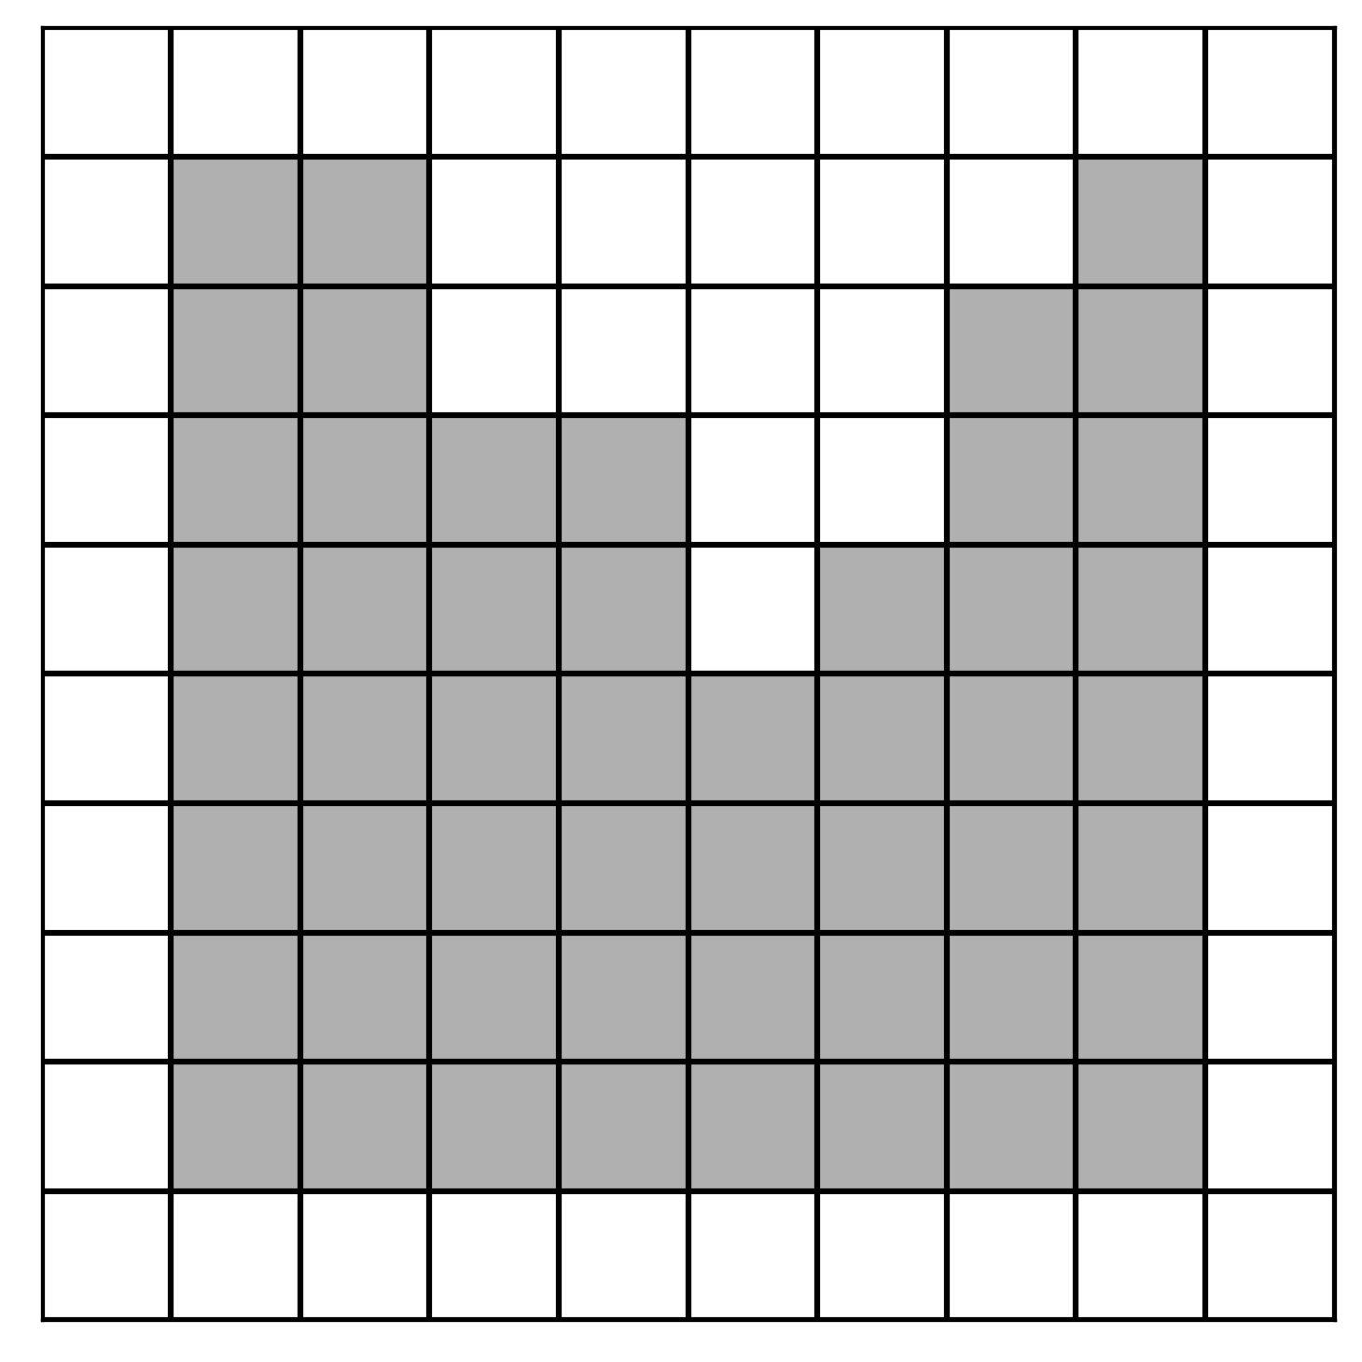
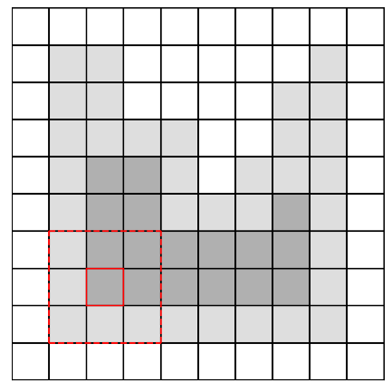
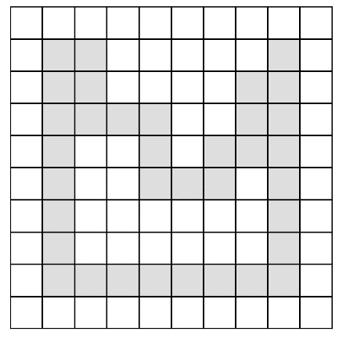
Boundary Extraction
GitHub: https://github.com/jerryweihuajing/Post-Processing

Slide 25
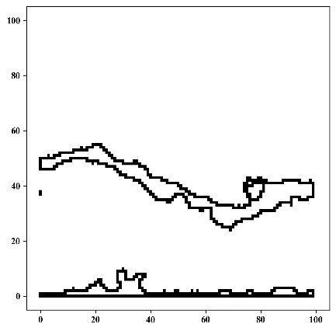
Boundary Extraction
GitHub: https://github.com/jerryweihuajing/Post-Processing

Slide 26
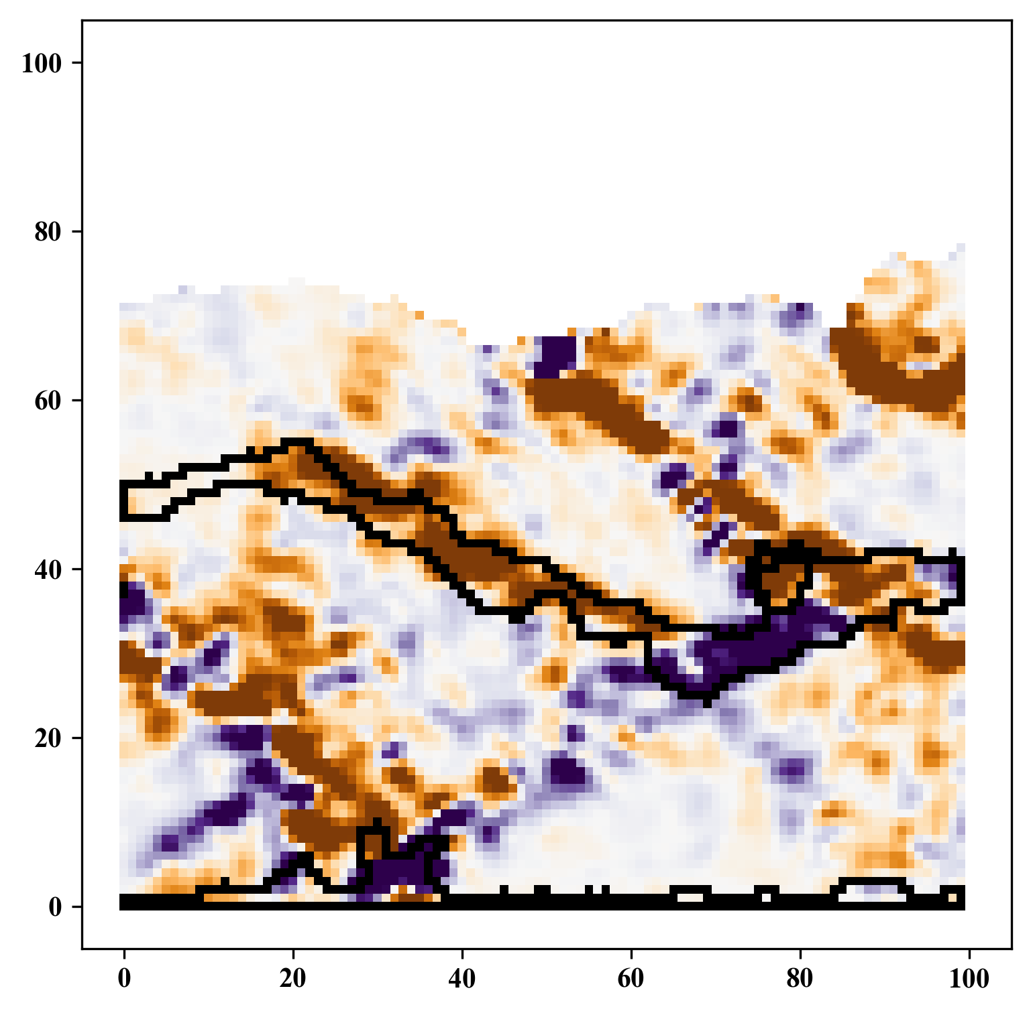
Boundary Extraction
GitHub: https://github.com/jerryweihuajing/Post-Processing

Slide 27
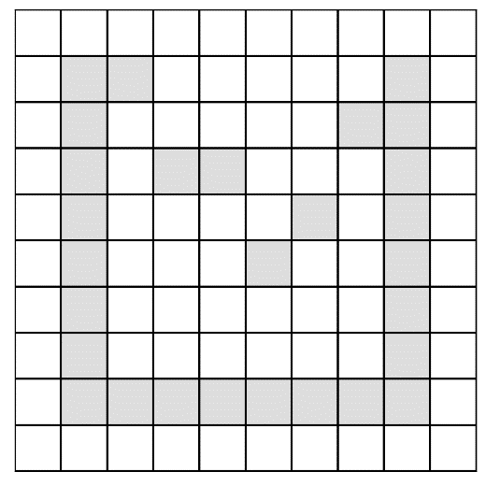
Outline Calculation
GitHub: https://github.com/jerryweihuajing/Post-Processing

Slide 28
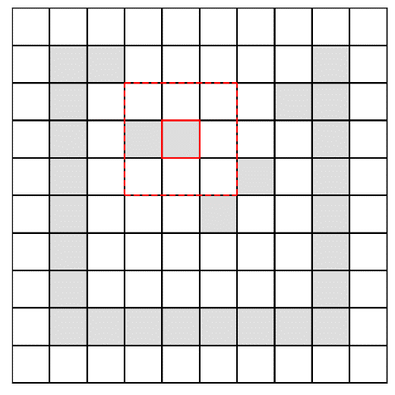
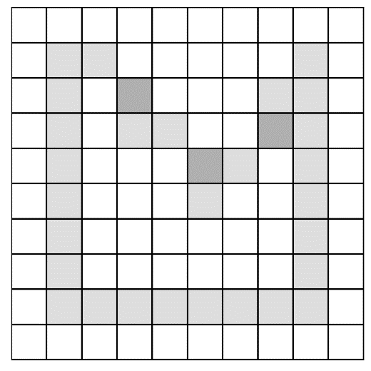
Outline Calculation
GitHub: https://github.com/jerryweihuajing/Post-Processing

Slide 29
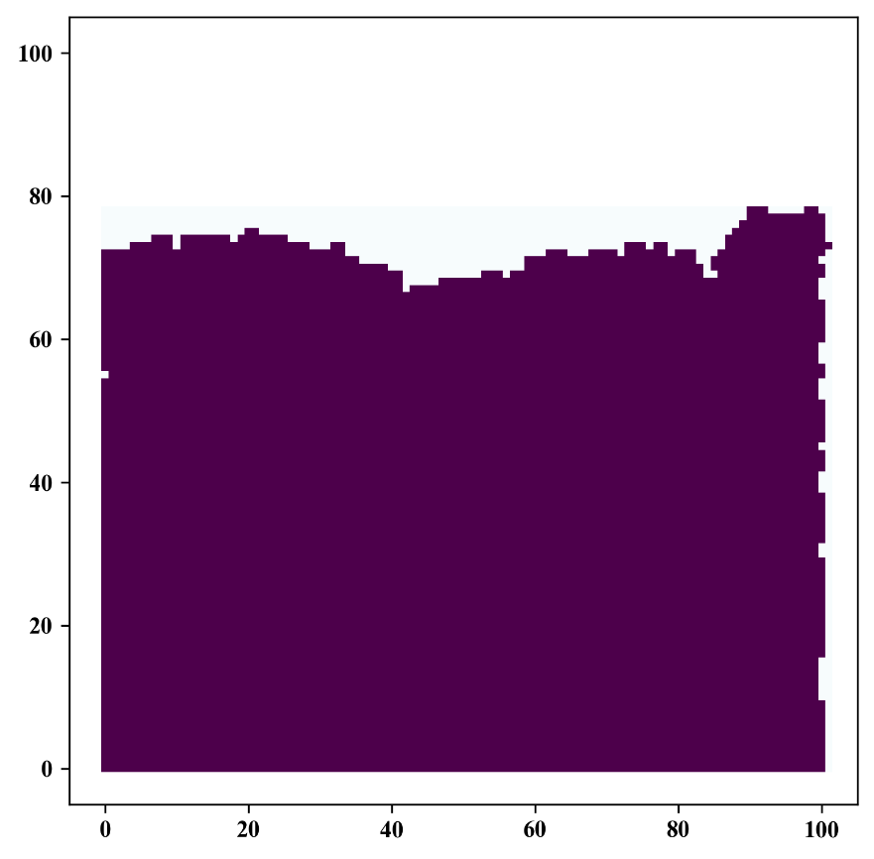
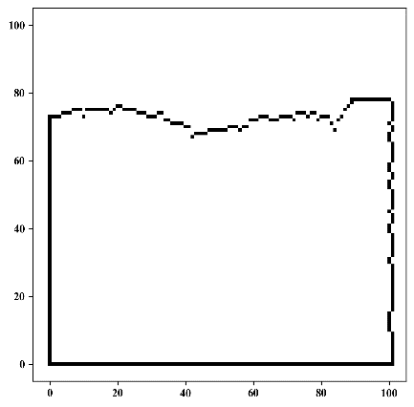
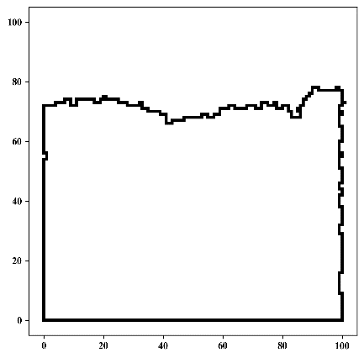
Outline Calculation
GitHub: https://github.com/jerryweihuajing/Post-Processing

Slide 30
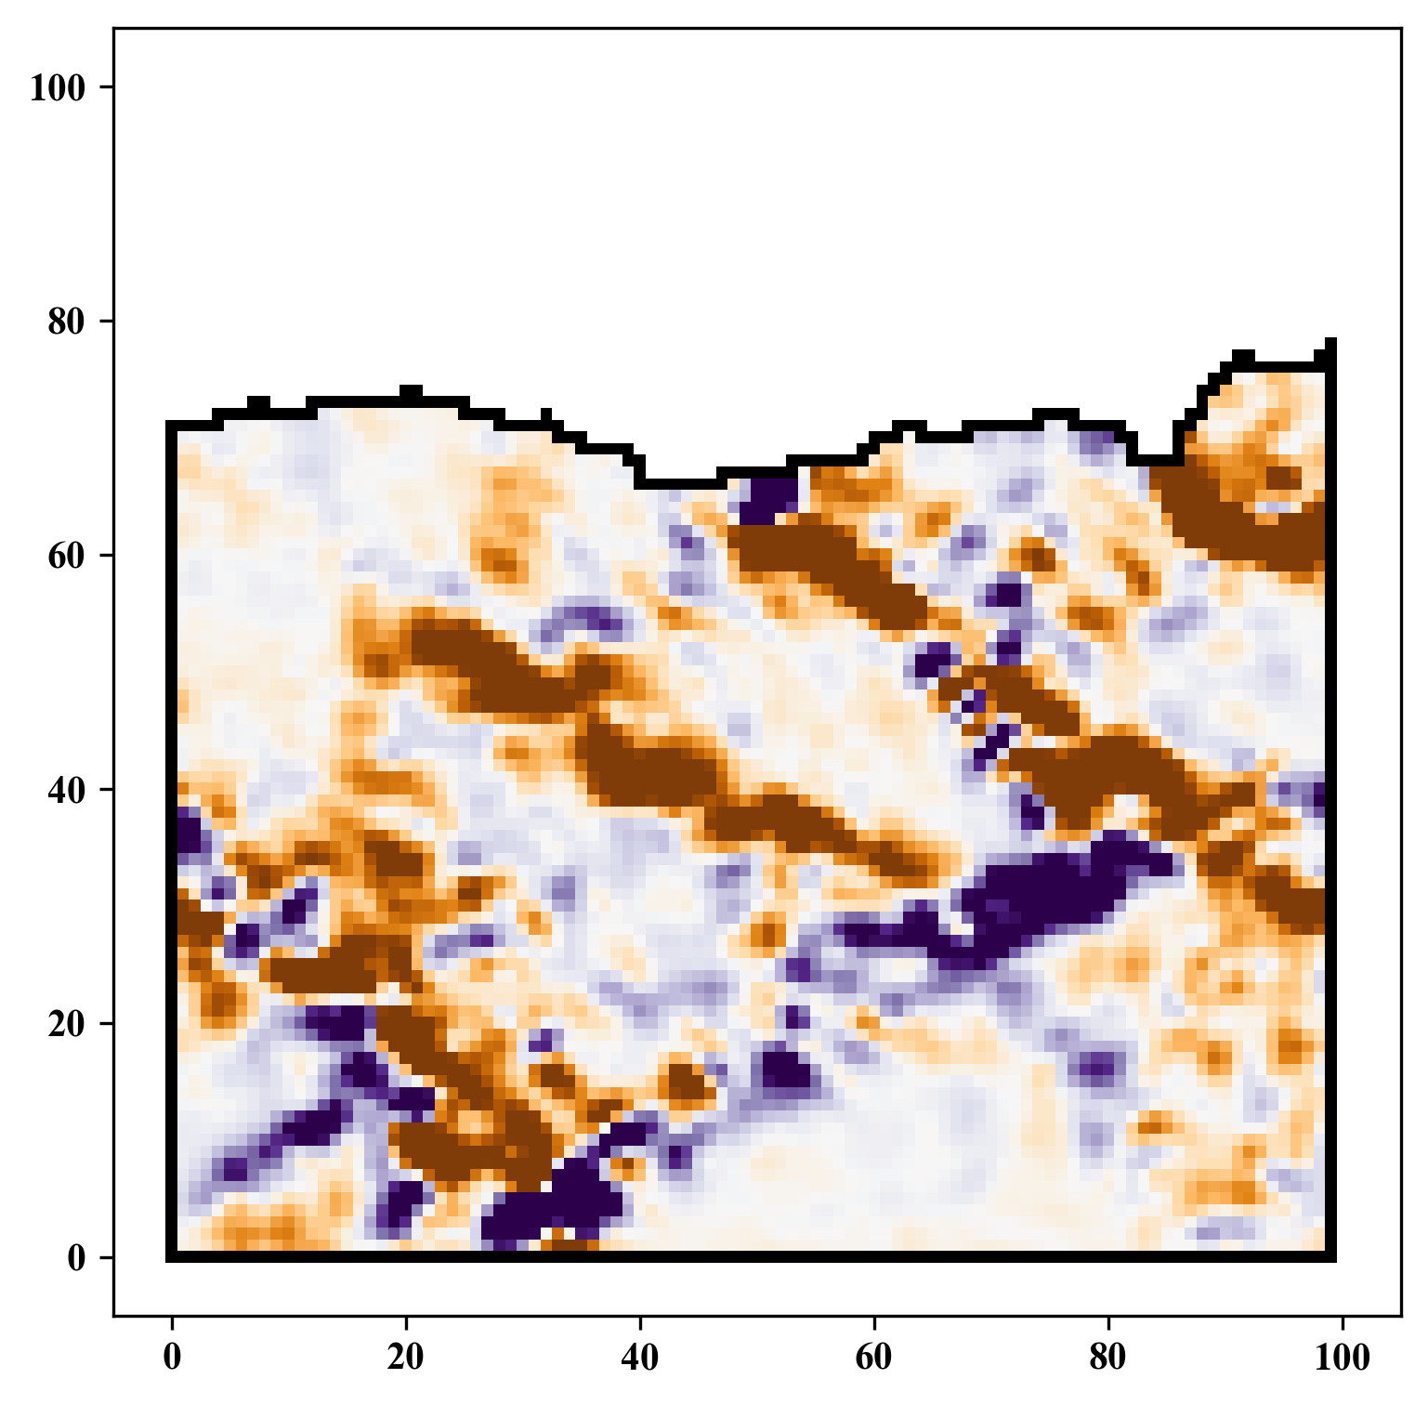
Outline Calculation
GitHub: https://github.com/jerryweihuajing/Post-Processing

Slide 31
Outline
Introduction
Algorithm
Example
Experiment
Conclusion

Slide 32
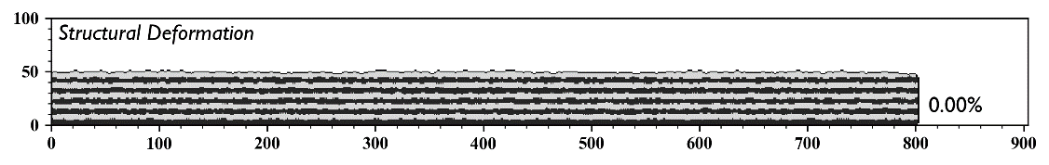
Model

Slide 33
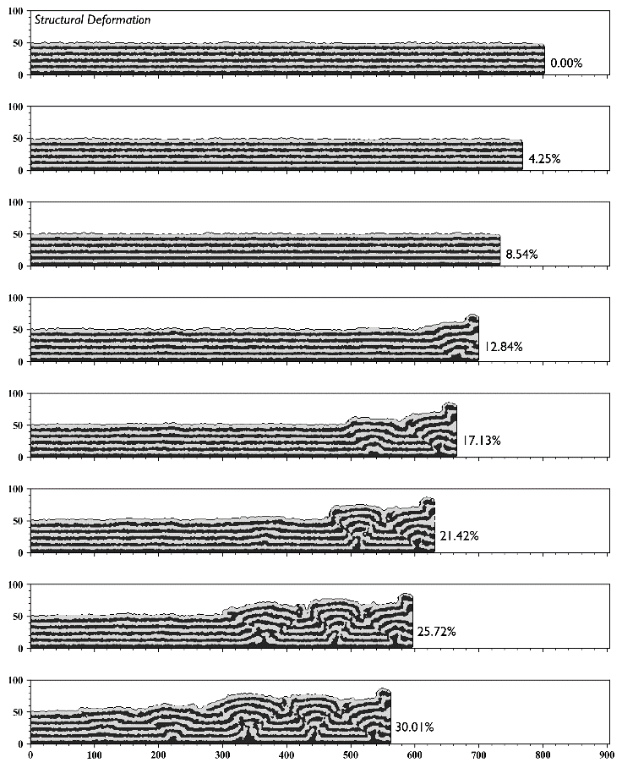
Structural Deformation

Slide 34
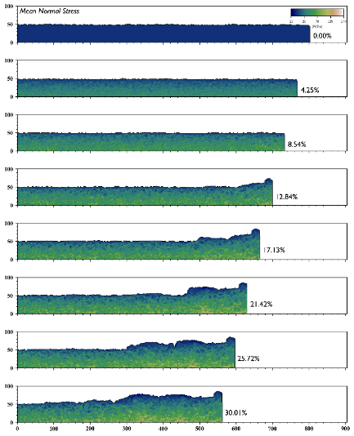

Mean Normal Stress & Maximal Shear Stress

Slide 35



Volumetric Strain

Slide 36



Distortional Strain

Slide 37



Velocity

Slide 38



X Displacement

Slide 39



Y Displacement

Slide 40



Velocity Gradient

Slide 41



X Displacement Gradient

Slide 42



X Displacement Gradient

Slide 43



Limitations of others

Slide 44



Limitations of others

Slide 45




Advantages of DEMpost

Slide 46





Advantages of DEMpost

Slide 47




Advantages of DEMpost

Slide 48
Outline
Introduction
Algorithm
Example
Experiment
Conclusion

Slide 49


Base

Slide 50


Salt Thickness

Slide 51


Salt Thickness

Slide 52




Salt Width

Slide 53




Salt(far away) Width

Slide 54




Salt Depth

Slide 55




Salt Offset

Slide 56




Fault Orientation

Slide 57




Fault Inclination(+)

Slide 58




Fault Inclination(-)

Slide 59




Fault Depth(+)

Slide 60




Fault Depth(-)

Slide 61


Fault Offset(+)

Slide 62


Fault Offset(+)

Slide 63


Fault Offset(-)

Slide 64


Fault Offset(-)

Slide 65




Fault Scale-from Bottom(+)

Slide 66




Fault Scale-from Bottom(-)

Slide 67




Fault Scale-from Surface(+)

Slide 68




Fault Scale-from Surface(-)

Slide 69
Conclusion

Slide 70
Acknowledgement
THANKS

